Slide 1




Cyber security approaches for Cloud/Edge Environments
Alessandro Carrega
TNT Lab – DITEN University of Genoa

Slide 2
Information
Lecturer: Dr. Alessadro Carrega.
Email: alessandro.carrega@unige.it.
Skype: alessandro.carrega@gmail.com.
Telegram / Whatsapp: 3487485497.
Duration: 20 hours.
Language: English.
Lesson in site and remote (Teams).

Slide 3
Information
Dedicated Teams channel:
PhD STIET Cyber security approaches for Cloud/Edge Environments
https://teams.microsoft.com/l/team/19%3a-Dtnw_NHUAl1AjZZV4HixIifmU8gywbskeeQwSV--uk1%40thread.tacv2/conversations?groupId=bdafff5c-0ab9-44b2-aef2-5a14e1dd6e15&tenantId=6cd36f83-1a02-442d-972f-2670cb5e9b1a
GitHub repository:
https://github.com/tnt-lab-unige-cnit/phd-stiet-cyber-security-approaches-cloud-edge-environments
Optional homework.
Available in Teams and GitHub.
Final Exam with two options:
Theoretical: short survey with 3 papers.
Pratical: 2 exercises.
Quiz: multiple choice questions.

Slide 4
Outline
Evolving computing paradigms
1
Virtualization, cloud computing, software orchestration
Software-oriented architectures and micro-services
Beyond the cloud: the Internet of Service and CPS
Cloud security aspects
2
Limitations of existing approaches
Evolving threats landscape
Cloud security approaches
Protecting the workload
3
Monitoring and visibility for cloud-based services: SIEM systems
Enhancing Elastic Stack
The ASTRID/GUARD architecture
Secure development, integration, and deployment pipelines

Slide 5
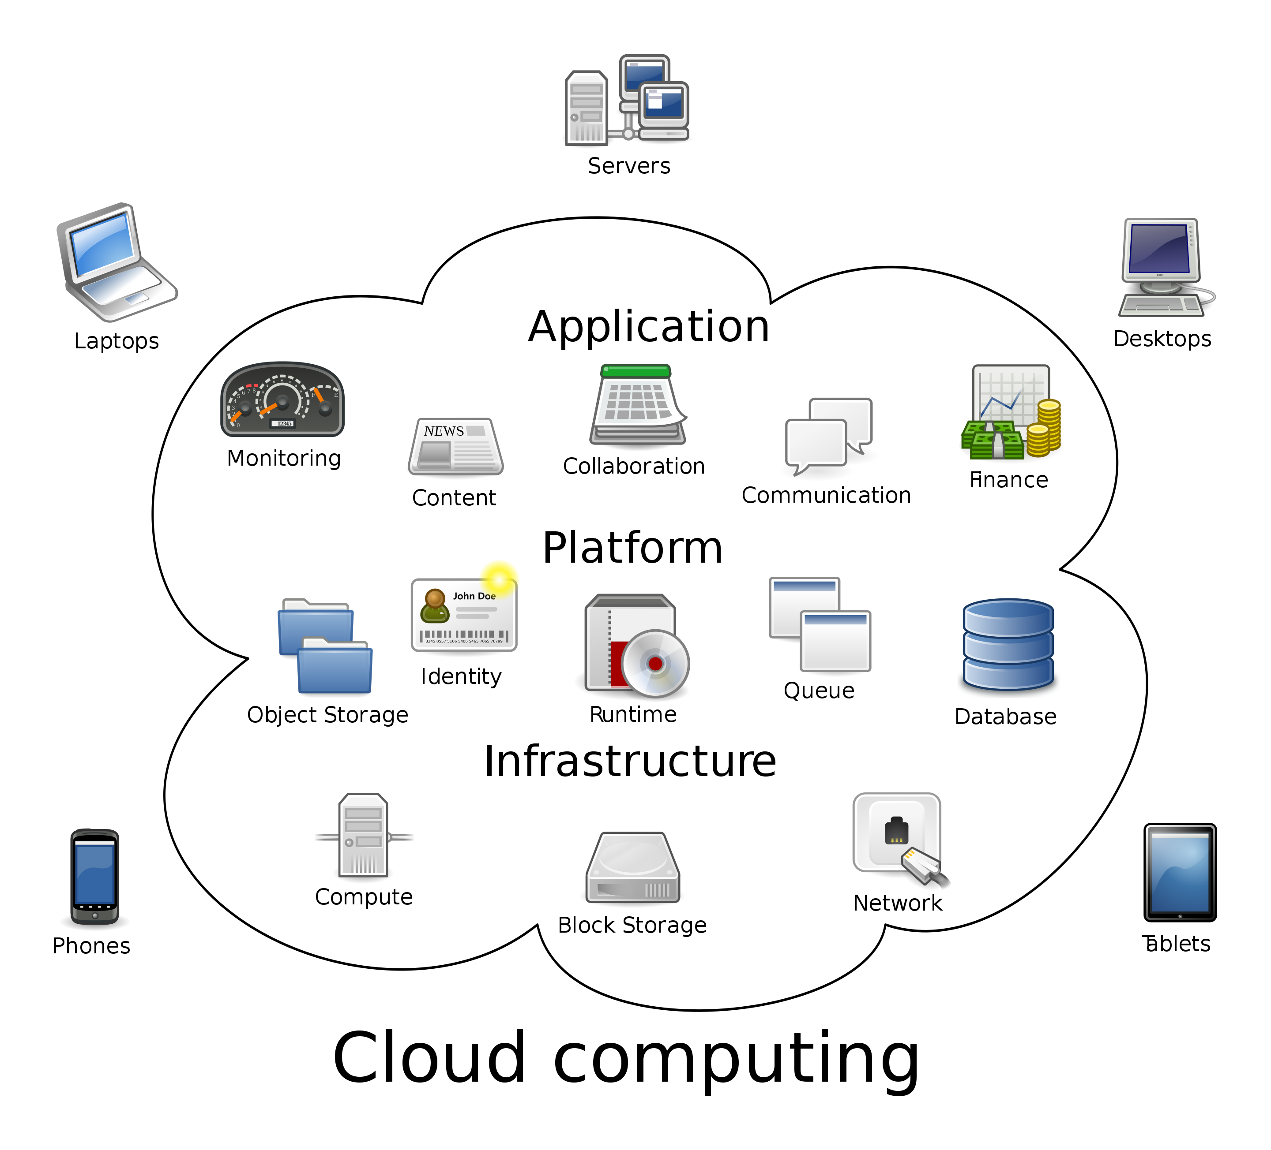
Cloud computing
Virtualization
XaaS paradigms: IaaS, PaaS, SaaS, NaaS, …
Sharing of resources (servers, networks, software, data)
Multitenancy
Private vs Public systems
Sharing of responsibility
Pay-as-you-go
Self-provisioning and software-defined

Slide 6



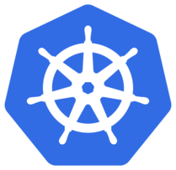










Cloud computing
Notes:
Today, many organizations are progressively moving their ICT processes in (private and public) clouds, motivated by the increasing agility to deploy and withdraw their services without caring about the physical infrastructure that host them. The cloud paradigm allows to run applications in a very flexible and cost-effective way.
There is no need to buy, deploy, and configure hardware, hence saving money and time.

Slide 7
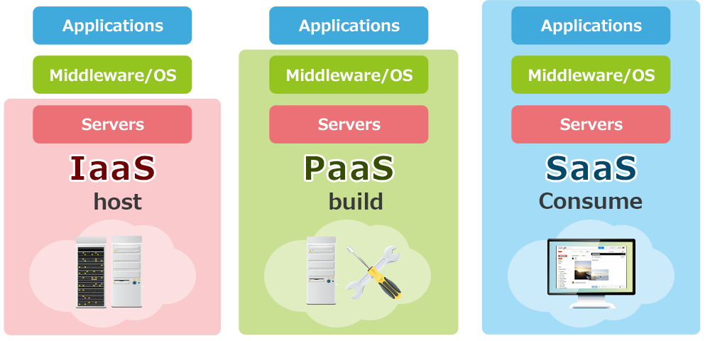
Cloud models: IaaS, PaaS, SaaS

Slide 8
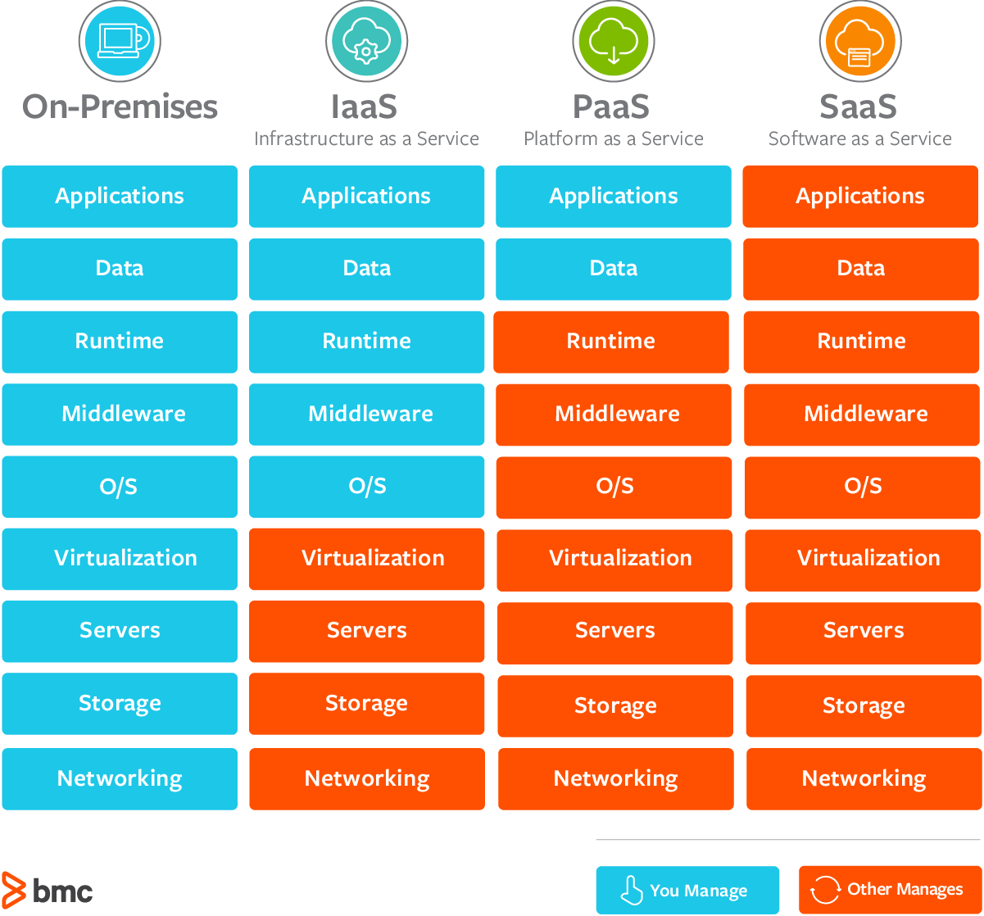
Cloud models: management

Slide 9
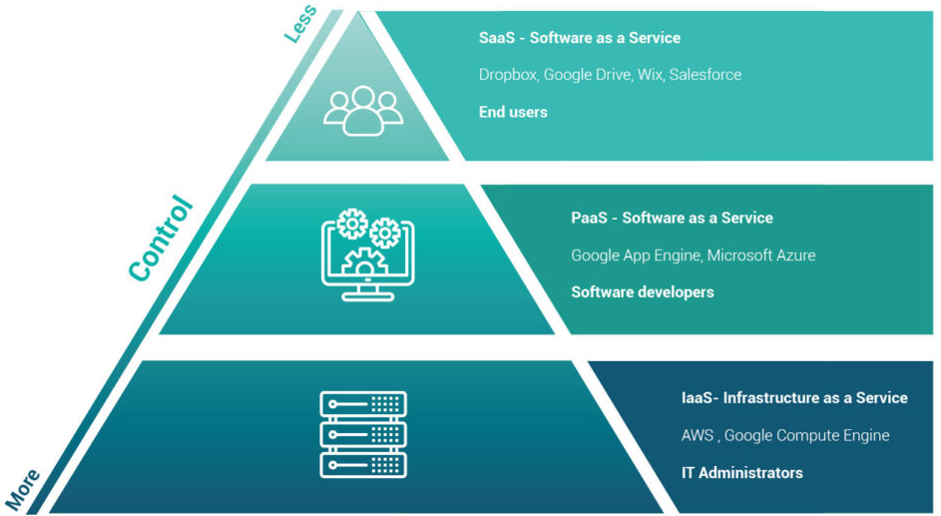
Cloud models: target users

Slide 10
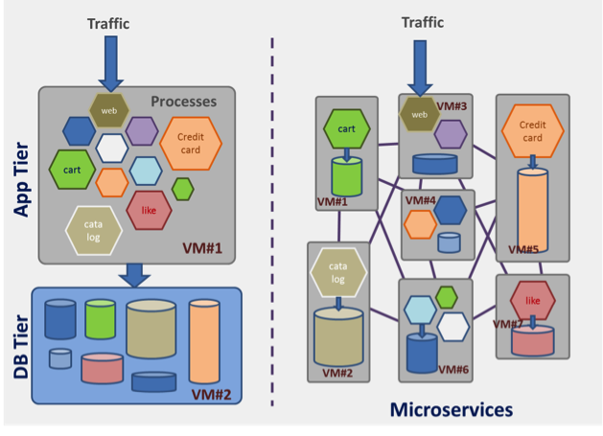
Beyond plain virtualization
New paradigms for software development, deployment and operation:
From "code writing” to “service chaining and configuration”
Re-usable components
Automated lifecycle management
Context-awareness and adaptability
Elastic services

Slide 11
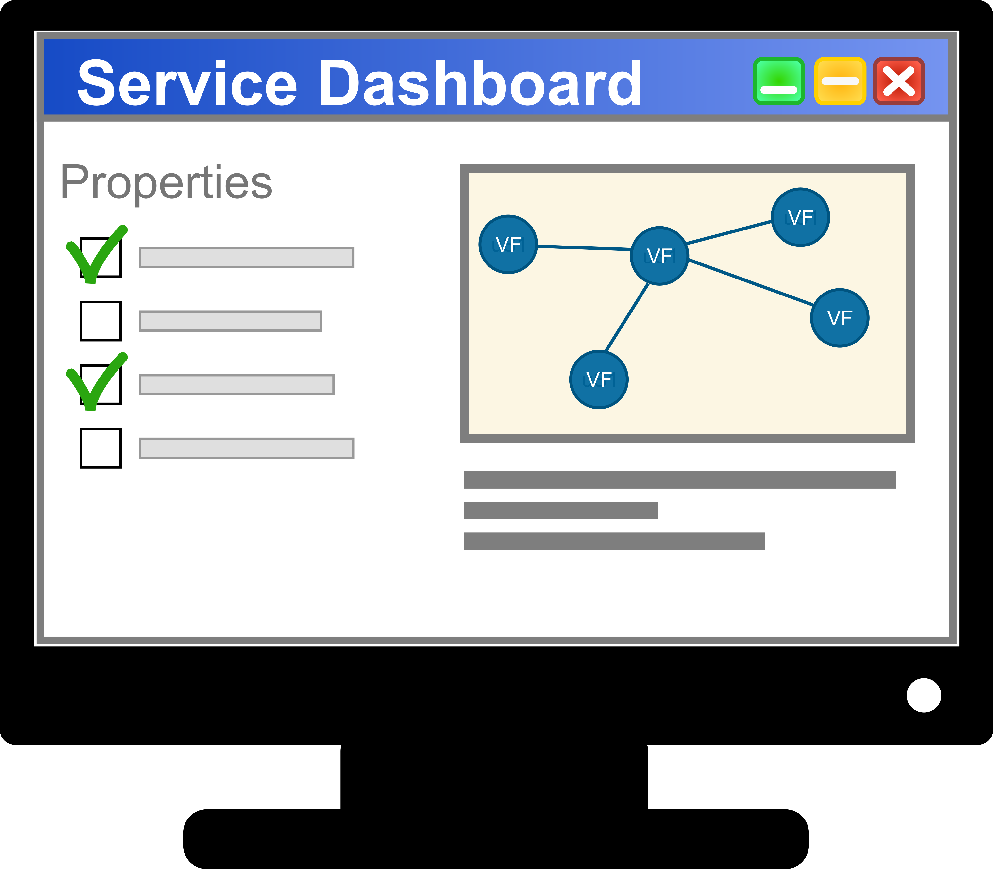

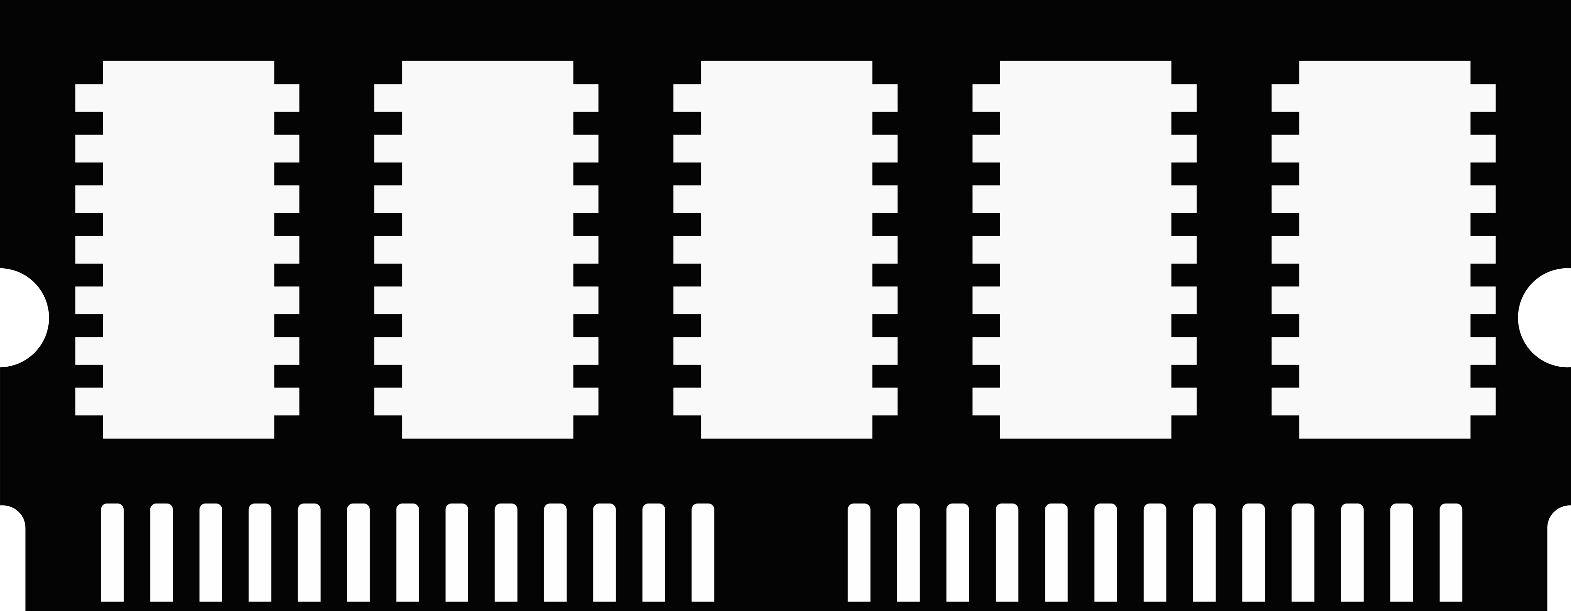

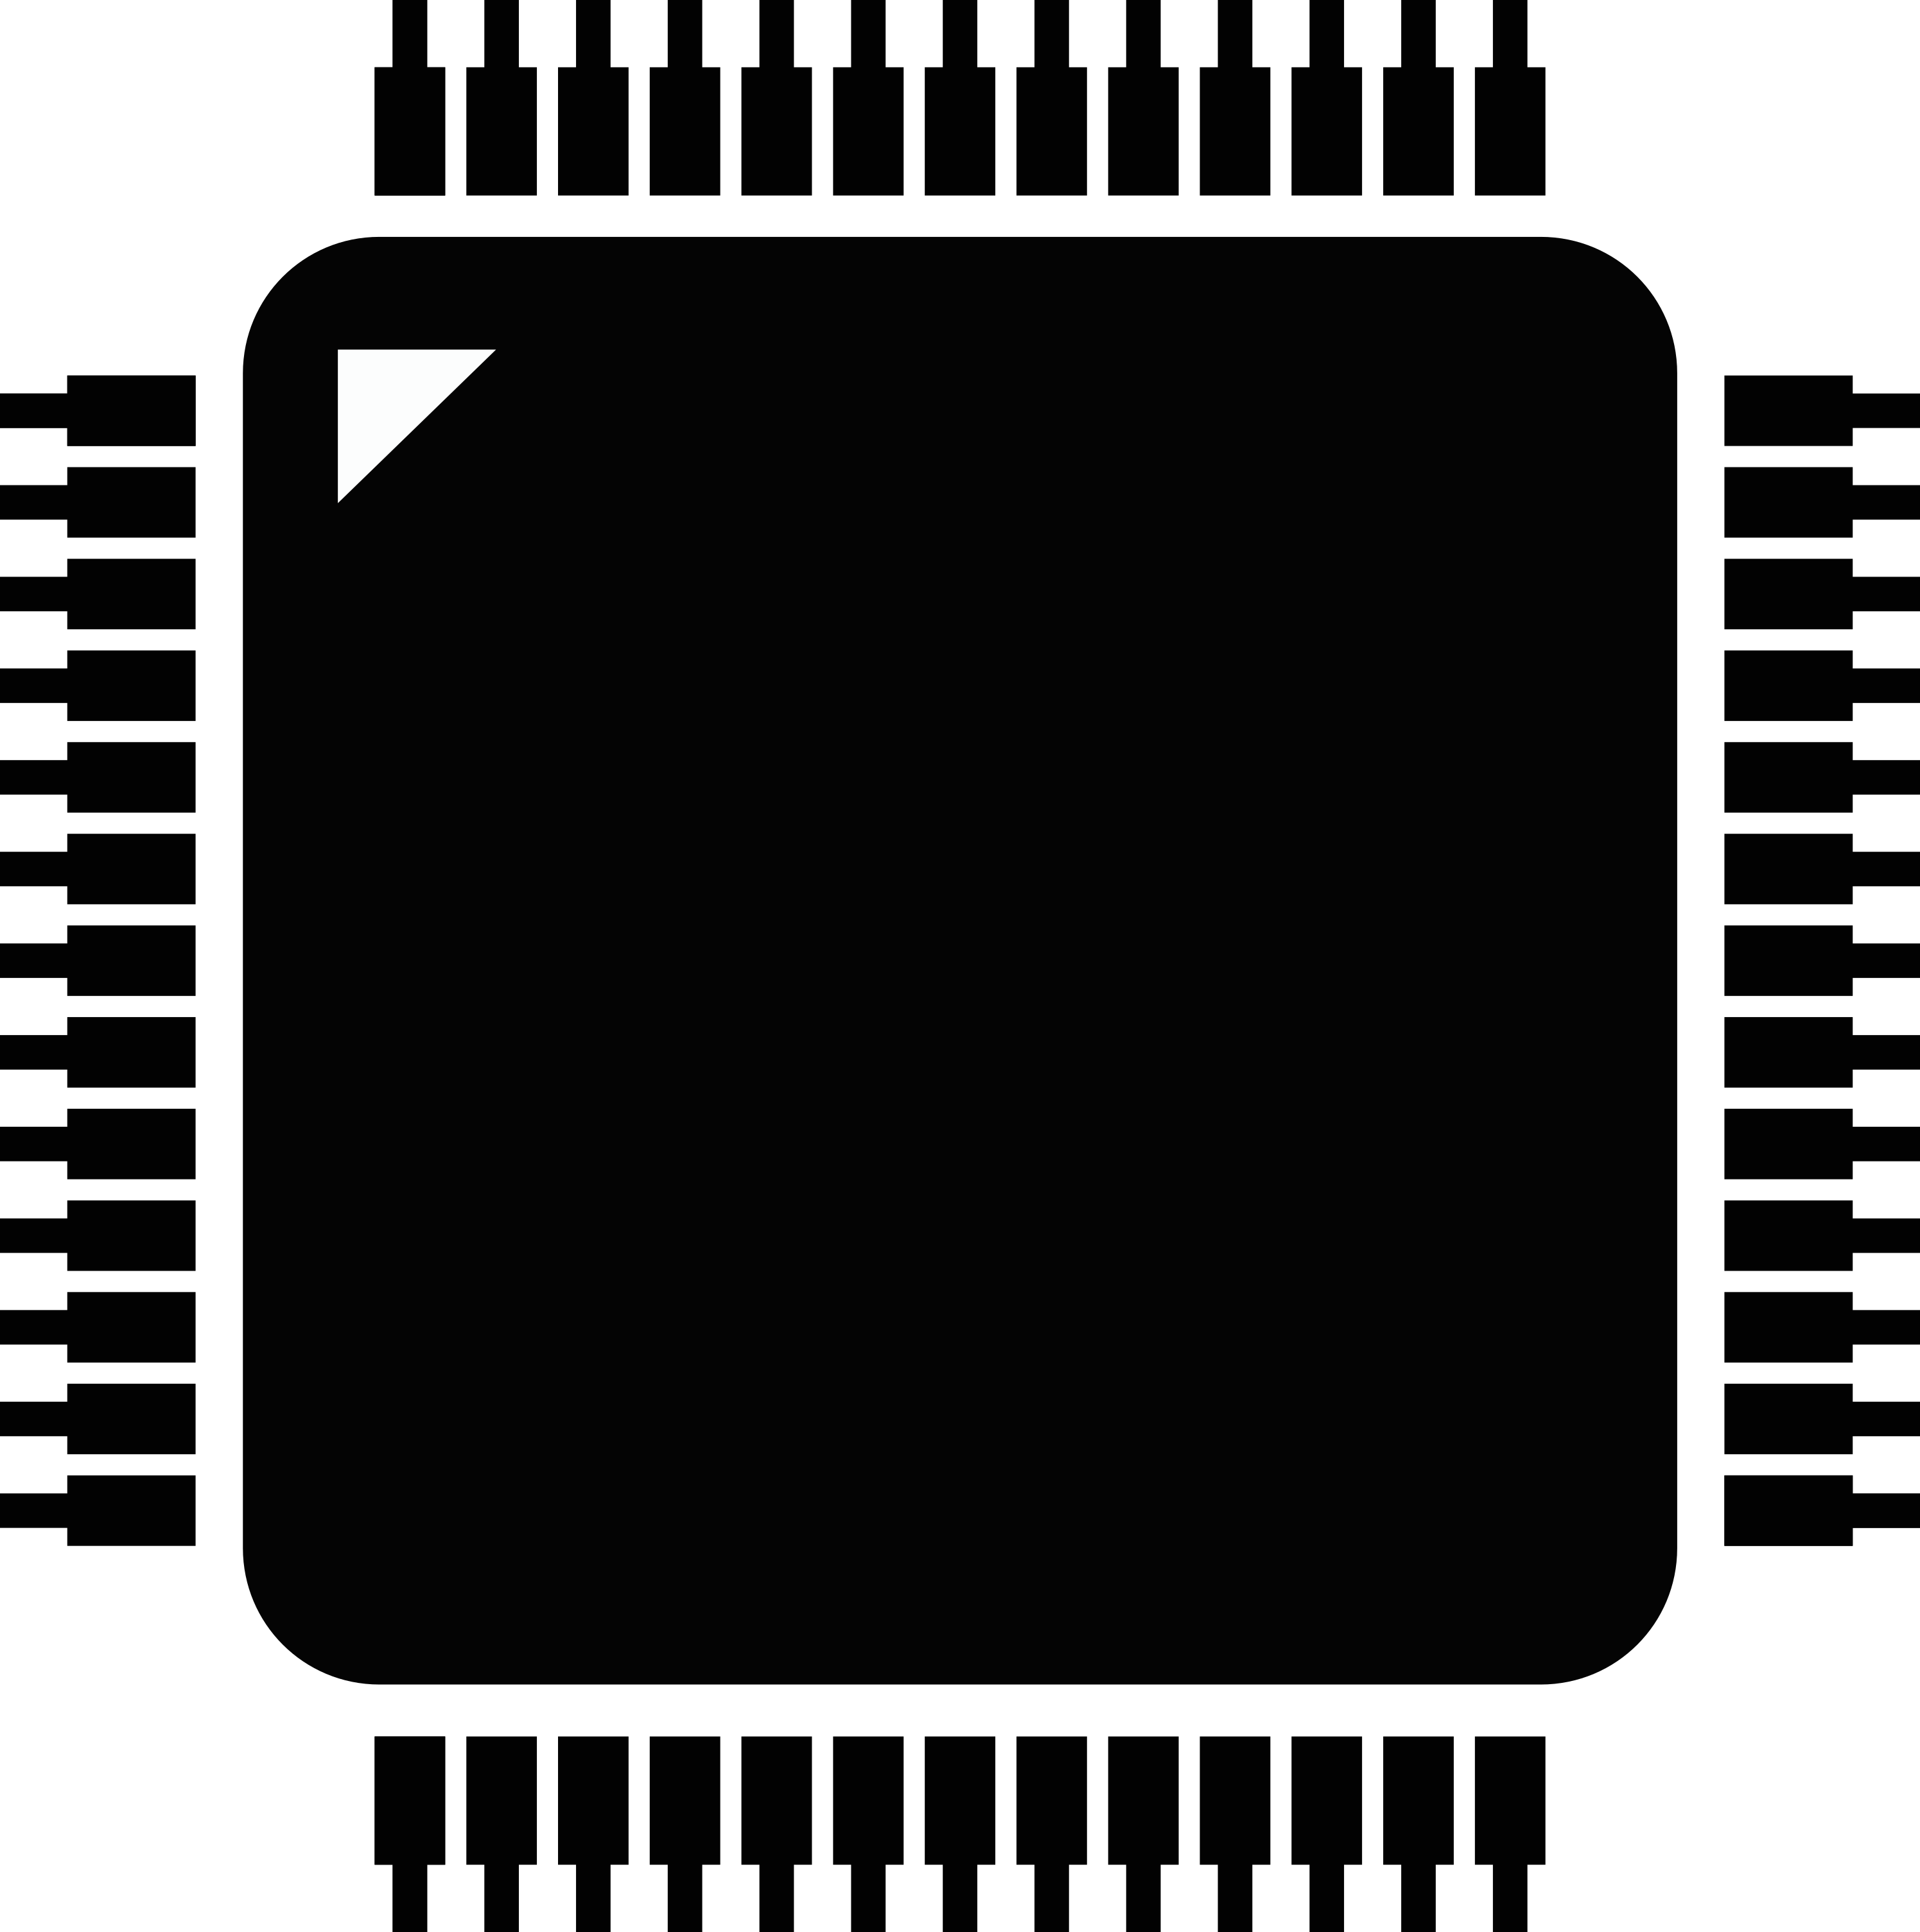

Software orchestration
Notes:
The Infrastructure-as-a-Service model leverages several virtualization technologies to abstract hardware and networking resources. Virtual CPU, virtual memory, virtual storage, and virtual networking are combined together to create Virtual Machines or other forms of software containers and to interconnect them in an isolated environment, where software can be installed and run in the same way as in a physical infrastructure.
One of the main operational benefits brought by the cloud paradigm is full control of the virtualization infrastructure through software APIs. The fully-digital management workflow allows large automation in deployment and lifecycle operations.
Orchestration software replaces humans for repetitive tasks, such as provisioning of virtual resources as well as installation and configuration of applications, driven by descriptive models based on imperative or declarative languages that capture the topology and behaviour of the service.

Slide 12
Software orchestration
Notes:
One major opportunity brought by the cloud paradigm is the possibility to deploy compound services over multiple installations, for backup, resilience, and locality purposes.

Slide 13
Software orchestration
Elasticity
Partially unpredictable
topology at design time!
Redundancy
Resilience
Notes:
The combination of dynamic provisioning and configuration management software allows to change the service at runtime, so to react to the evolving context, hence providing elasticity, redundancy, and resilience. Most important, such changes can be automated, by defining suitable management policies in the service template.
Eventually, the ability to adapt to the evolving context makes the service topology partially unpredictable at design-time, which may be a major issue for security.

Slide 14
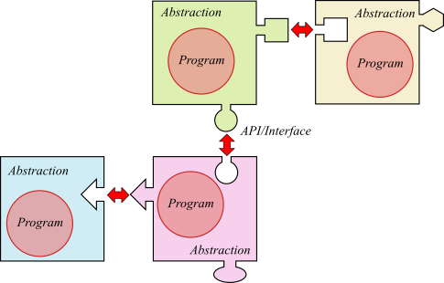
Service orchestration
Service model
description
capabilities (what the component does)
properties (configuration elements),
requirements (virtual resources, libraries, other components), and
management operations (e.g., install, start, stop, scale, monitor).
Orchestration
deploy the service in the underlying virtualization infrastructure
perform life-cycle management actions.
Examples: TOSCA, ETSI NFV, IETF SFC, FIWARE, Kubernetes, Docker Swarm, Apache Mesos.

Slide 15
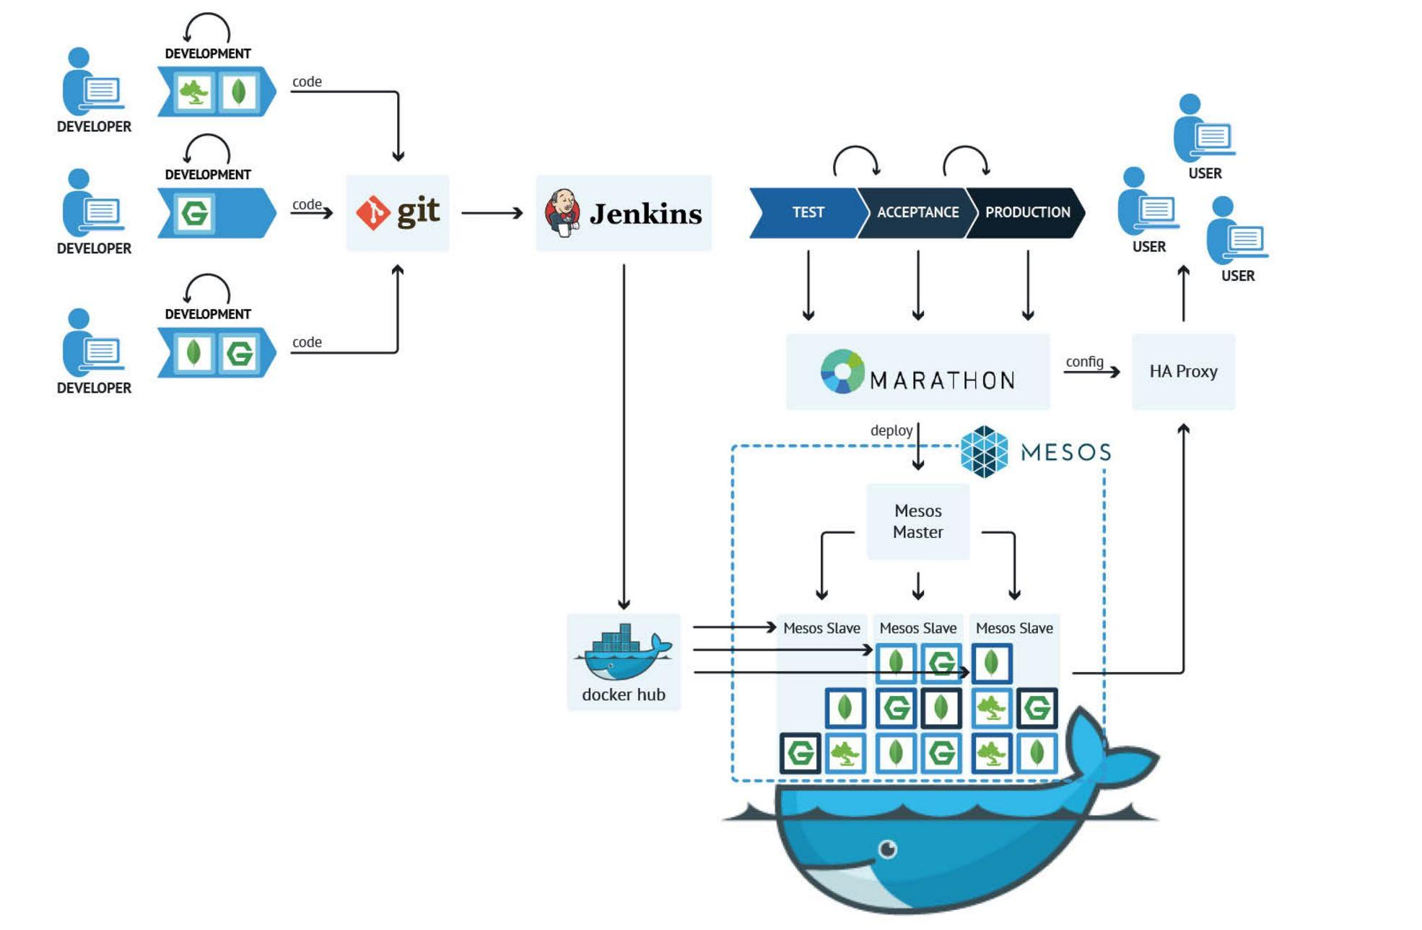
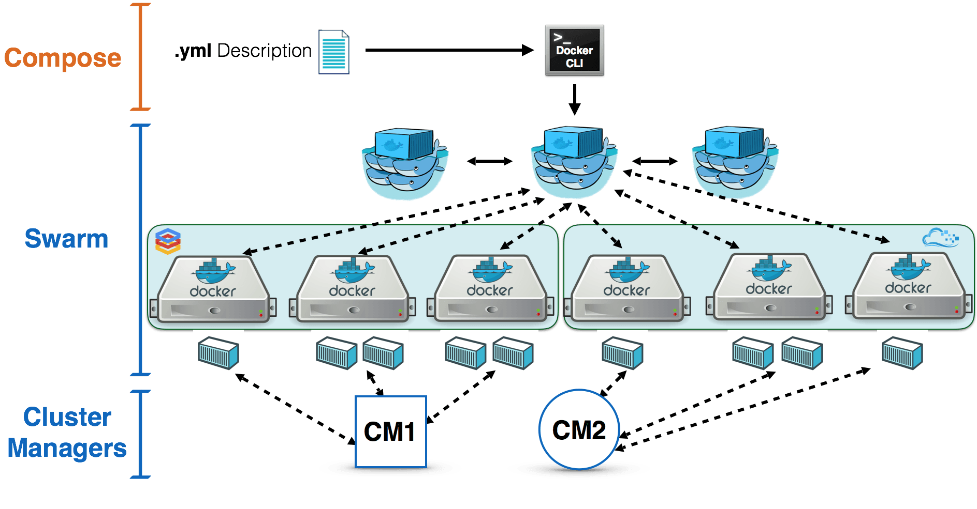
Orchestration - Examples
Docker Swarm
Apache Mesos

Slide 16
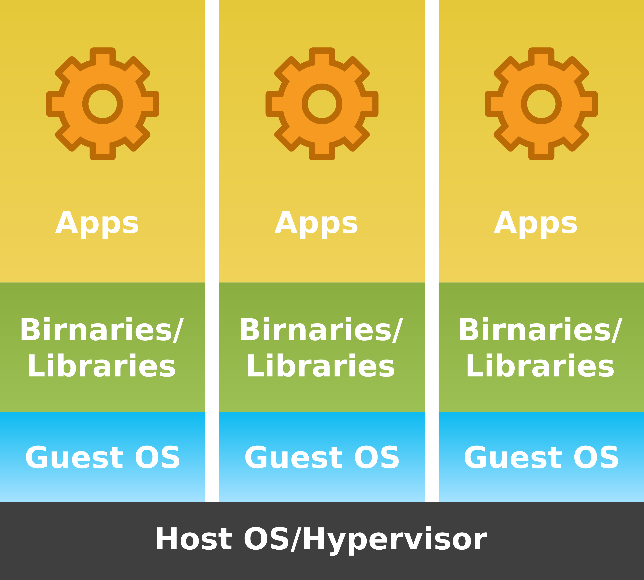
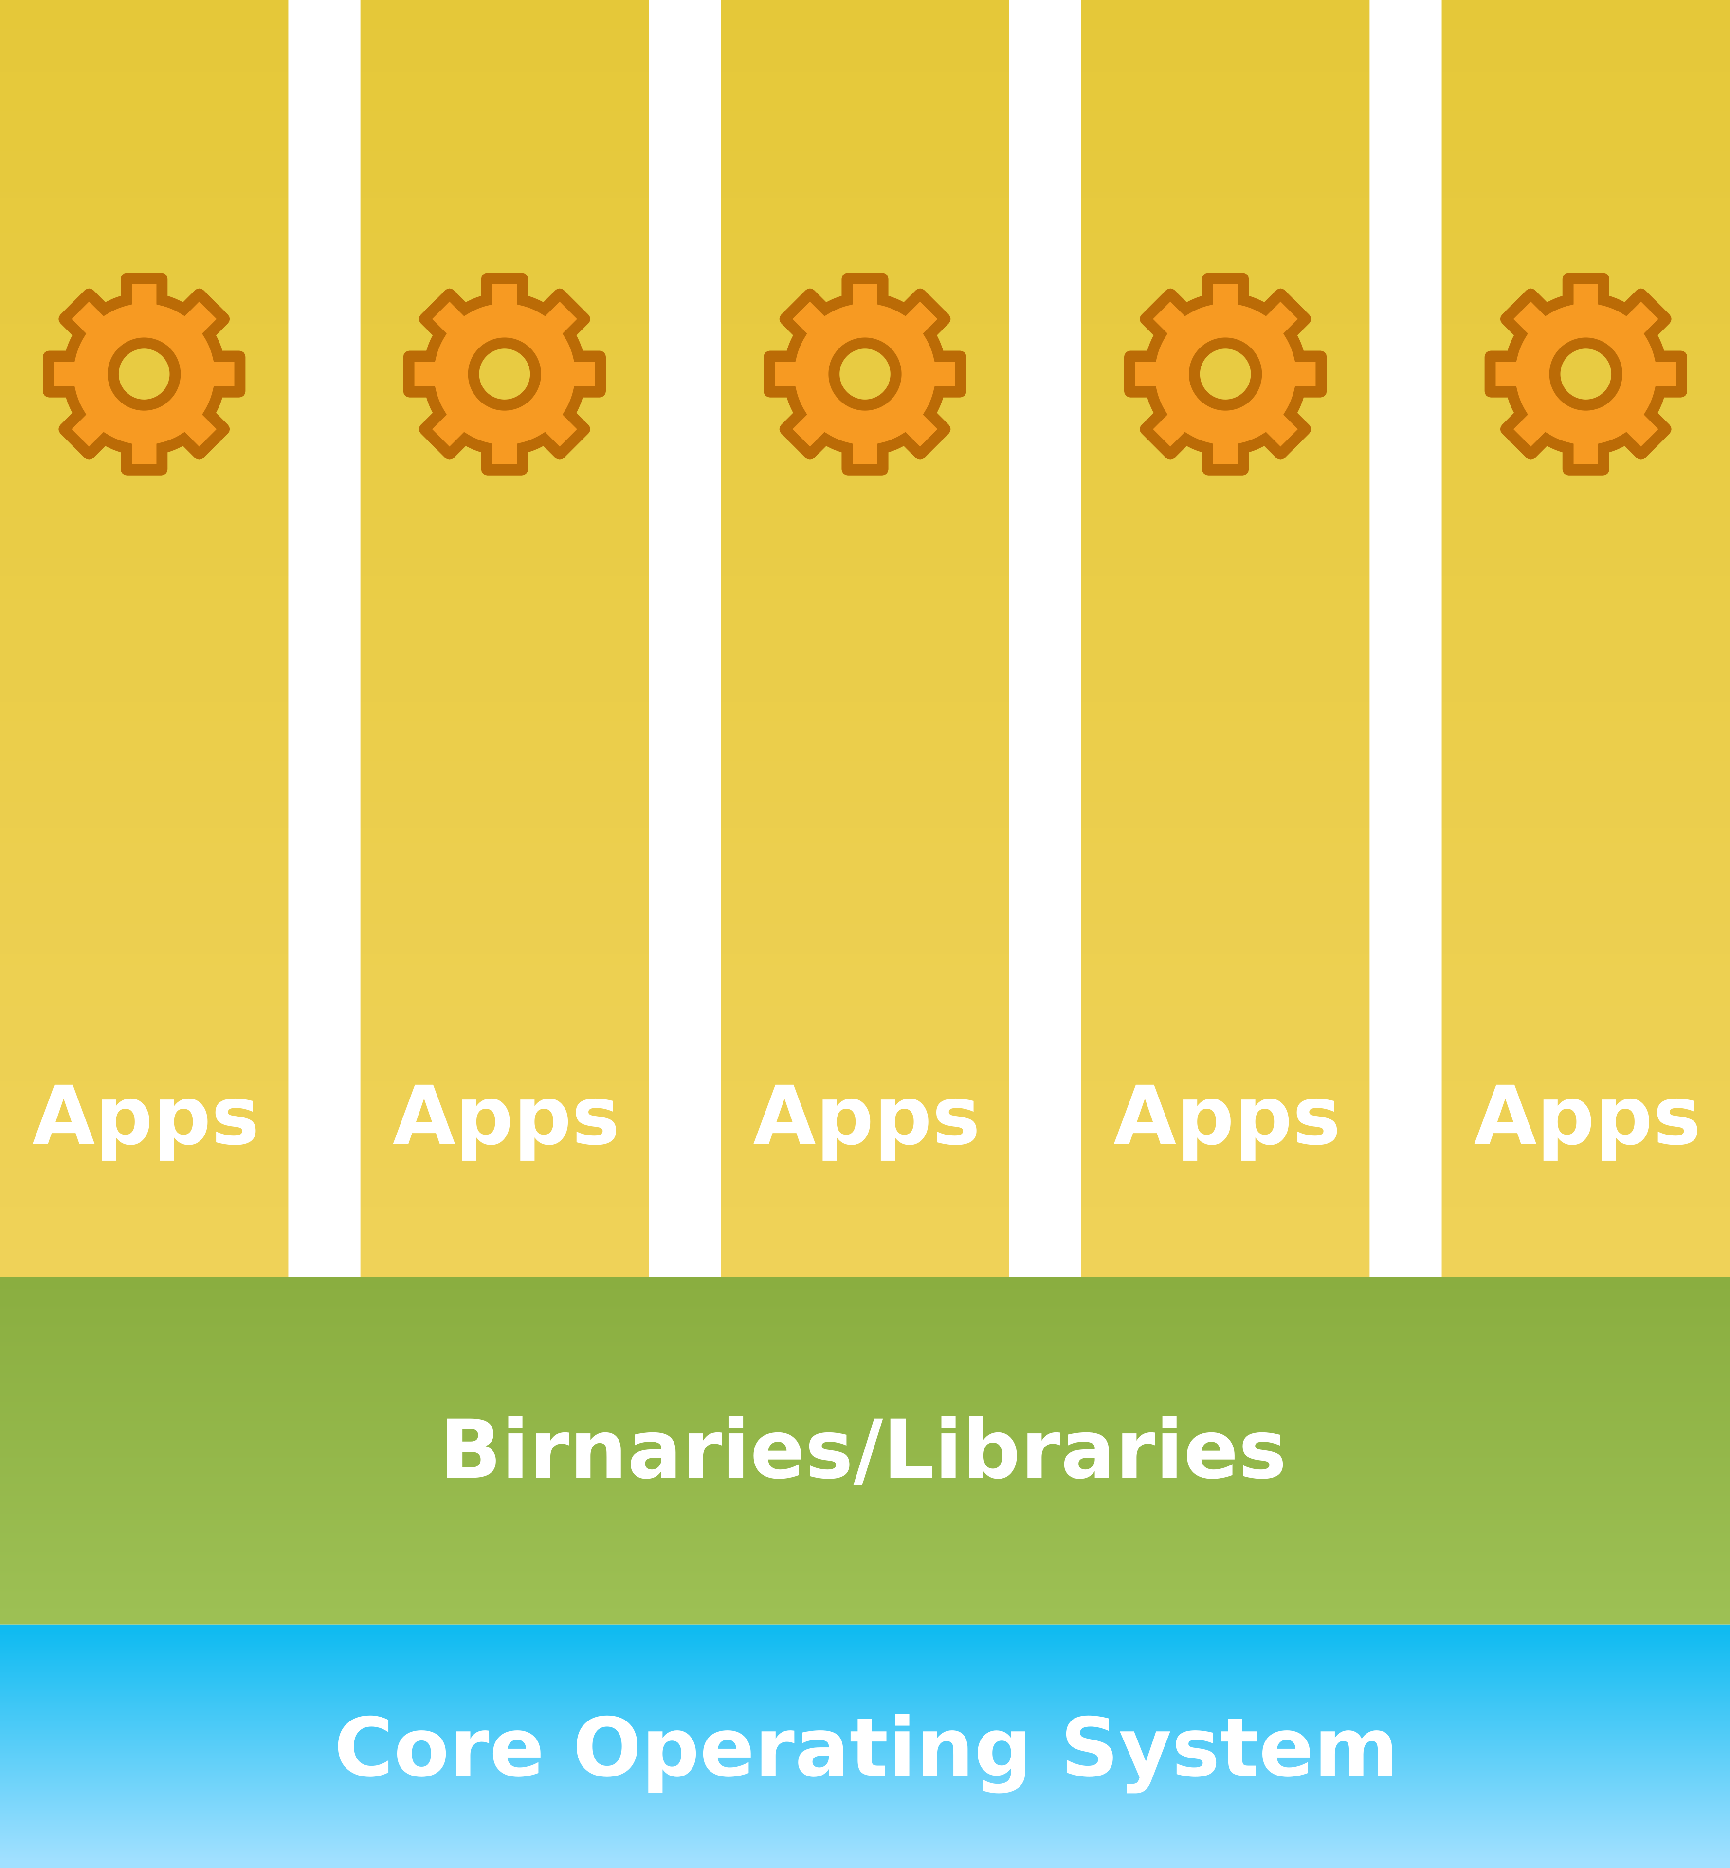
Trends in virtualization…
From VMs…
to lightweight containers

Slide 17
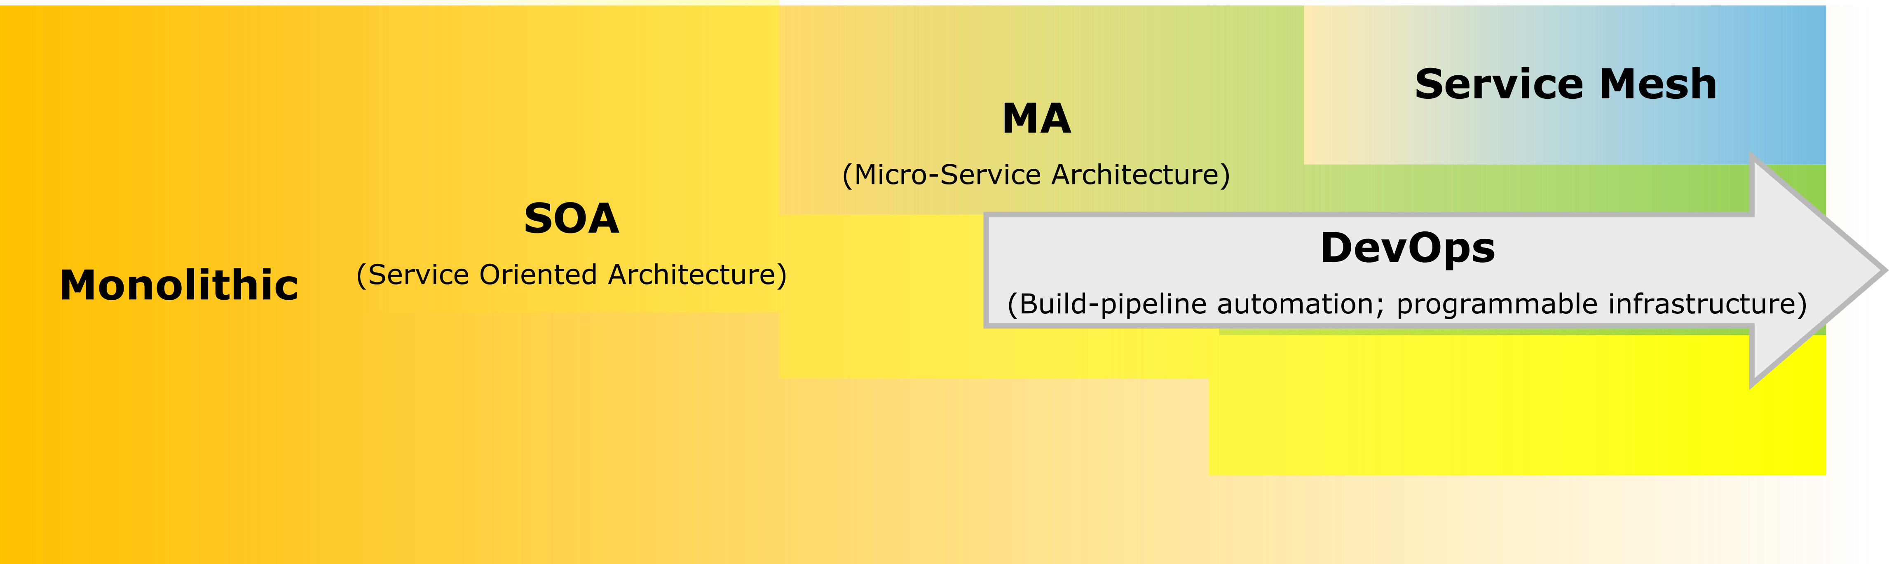
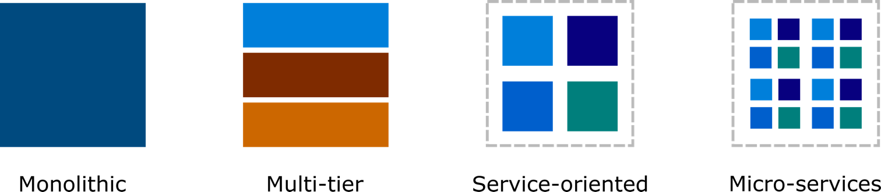
… and software architectures
Notes:
Software engineering has probably never evolved so fast as in the last twenty years. Following the progressive introduction of virtualization paradigms first and cloud model later, architectures have progressively evolved from monolithic to distributed and scalable frameworks.
The term “monolithic” does not necessary imply the lack of modularity or extensibility; indeed, best practice for software design has been available for long. Monolithic software is commonly written in a single language, makes use of quite rigid inter-process communication facilities (which usually depend on the specific language or operating system), and cannot easily be changed at run time. Monolithic applications are usually contained in a common “project” and distributed as a single package. The large collection of functions, even if systematically grouped in different files, makes it hard to modify and test the whole application. As a matter of fact, every small modification must undergo full testing of the whole project before delivering to production. The only way to scale is replicating the entire application, which leads to higher resources and costs. The logical organization in multiple tiers facilitate the design, implementation, and maintenance of the application, but does not bring substantial benefits for scaling and testing.
Chasing more agility in the development and operation pipelines, the next step was the introduction of service-oriented architectures. The ground concept is the decomposition of applications in multiple business units, each one with specific functions. For example, an e-commerce application could be decomposed in Authentication block, Order block, Notification block. This greatly improves scalability, since each business unit becomes a standalone block, which is simpler to design, maintain, and distribute. The main drawback of this approach was the useless complexity of legacy abstractions and protocols, where each service spoke a different language and an additional layer was required for communication (Enterprise Service Bus).
Following this evolution, micro-services removed the need for common ancillary services (like back-end databases), by encapsulating both logic and data [32]. The idea of micro-services is that they are stand-alone service units completely decoupled and isolated from each other, designed according to the principle of “single responsibility.” As such, the internal logic of each micro-service can be implemented with different hardware technologies and programming languages (C/C++, Node, Go, Python, Java, Scada, Kotlin, …); this requires to expose an interface which is portable and independent from the coding language. Common choices are based on HTTP like REST (SOAP is another possibility, but again more rigid and heavier than the lightweight and free format REST), gRPC (Google RPC – which provide a binary encoding which is more efficient compared to REST) and Apache Thrift (which provisions for streaming events).

Slide 18
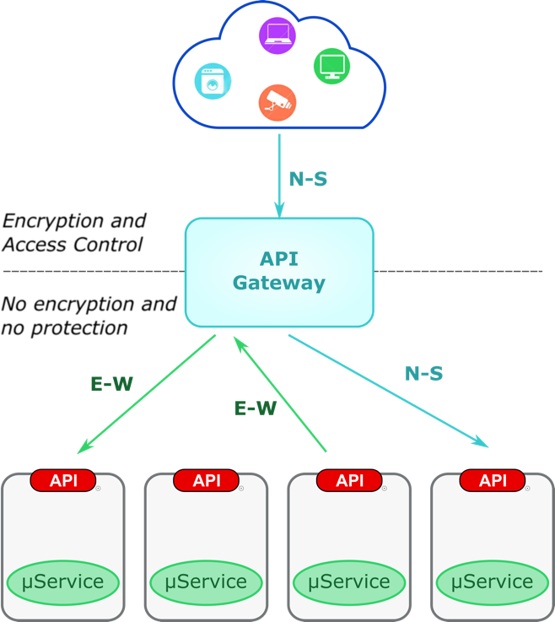
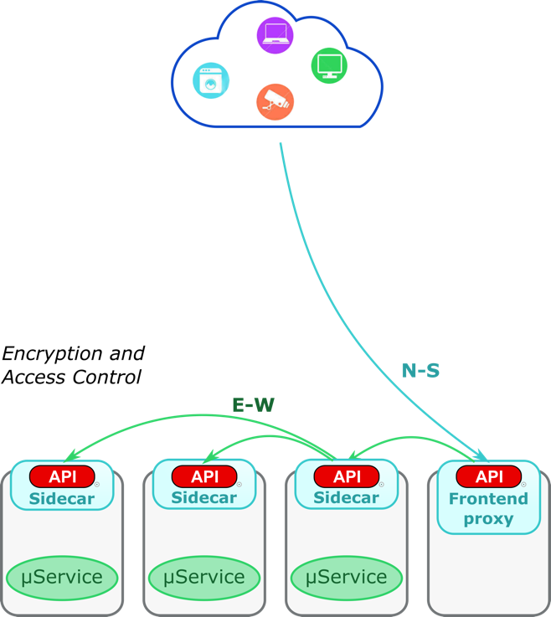
(Micro-)service-oriented architectures
Micro-services
Service meshes
Notes:
Applications are built by combining functions provided by each micro-service. The loosely couple nature of micro-services allows to replace, duplicate, or remove part of them without affecting operation of the overall architecture. Services can hence grow or shrink dynamically according to the evolving workload, update specific functions or protocols, be deployed over multiple and even heterogeneous infrastructures.
The ground assumption is the ability to discover micro-services and related functions, which entails the presence of service registries. In addition, load balancers are commonly used to implement horizontal scaling. Though there are not rigid patterns, typical architectures use an API gateway that route and secure requests that come from outside (North-South) traffic as well as relied upon as central load balancer for East-West service calls (see Figure 14.a). With the introduction of an API Gateway, there is still a weak form of perimeter in the application; all E-W traffic may happen in clear text, whereas only communications that are situated north of the gateway are encrypted.
The latest step in this evolution tried to go beyond the heterogeneity in the implementation of external APIs. As a matter of fact, different codes, different languages, and different internal architectures usually lead to inconsistent semantics, methods, encryption schemes, authentication mechanisms, access policies, logging and so on. The API gateway definitely represents a potential bottleneck and single point of failure, so the natural evolution was to break this functionality down within each service. A common and shared component therefore is placed alongside the main business logic as a lightweight sidecar that acts like a communication proxy and provides the front-end communications (e.g., HTTPS, RPC, AQMP/HTTP) and security functions (Figure 14.b). Recently, Envoy has emerged to implement this concept for containers. This speeds up integration and development, since programmers can now focus on the main business logic without wasting their time to implement communication protocols. It also facilitates management of the overall application, since consistent data and measurements are available to monitor the health of the service and alert in case of potential issues. A specific requirement, however, is to keep the additional layer introduced by the sidecar as thin as possible (in terms of computation overhead and latency), since it must not lead to performance degradation or interfere with usual telemetry.
The architecture now becomes fully distributed and the boundary between N-S and E-S communications blurs, since every service can be leverage as a public interface (even if dedicated proxies can still be deployed as public frontends). The invocation of complementary functions creates a logical “chain” of services. The result is a fully decentralized service mesh, without any sort of security perimeter, which applies peer-to-peer encryption, authentication, and access control functions. A subsidiary framework is anyway still needed to mediate security properties and establish trust relationships, for instance by distributing certificates, collecting logs and performance measurements, assessing the global health. This logic is already implemented by ISTIO; from the security perspective, observability is limited to logs and metrics collected by Envoy and Prometheus.
Envoy: https://www.envoyproxy.io/.
ISTIO: https://istio.io/.
Prometheus: https://prometheus.io/.

Slide 19


Beyond the cloud: the Internet of Services
Internet of Things
+
Communication networks
+
Internet of services
Physical
surrounding
=
Smart services

Slide 20
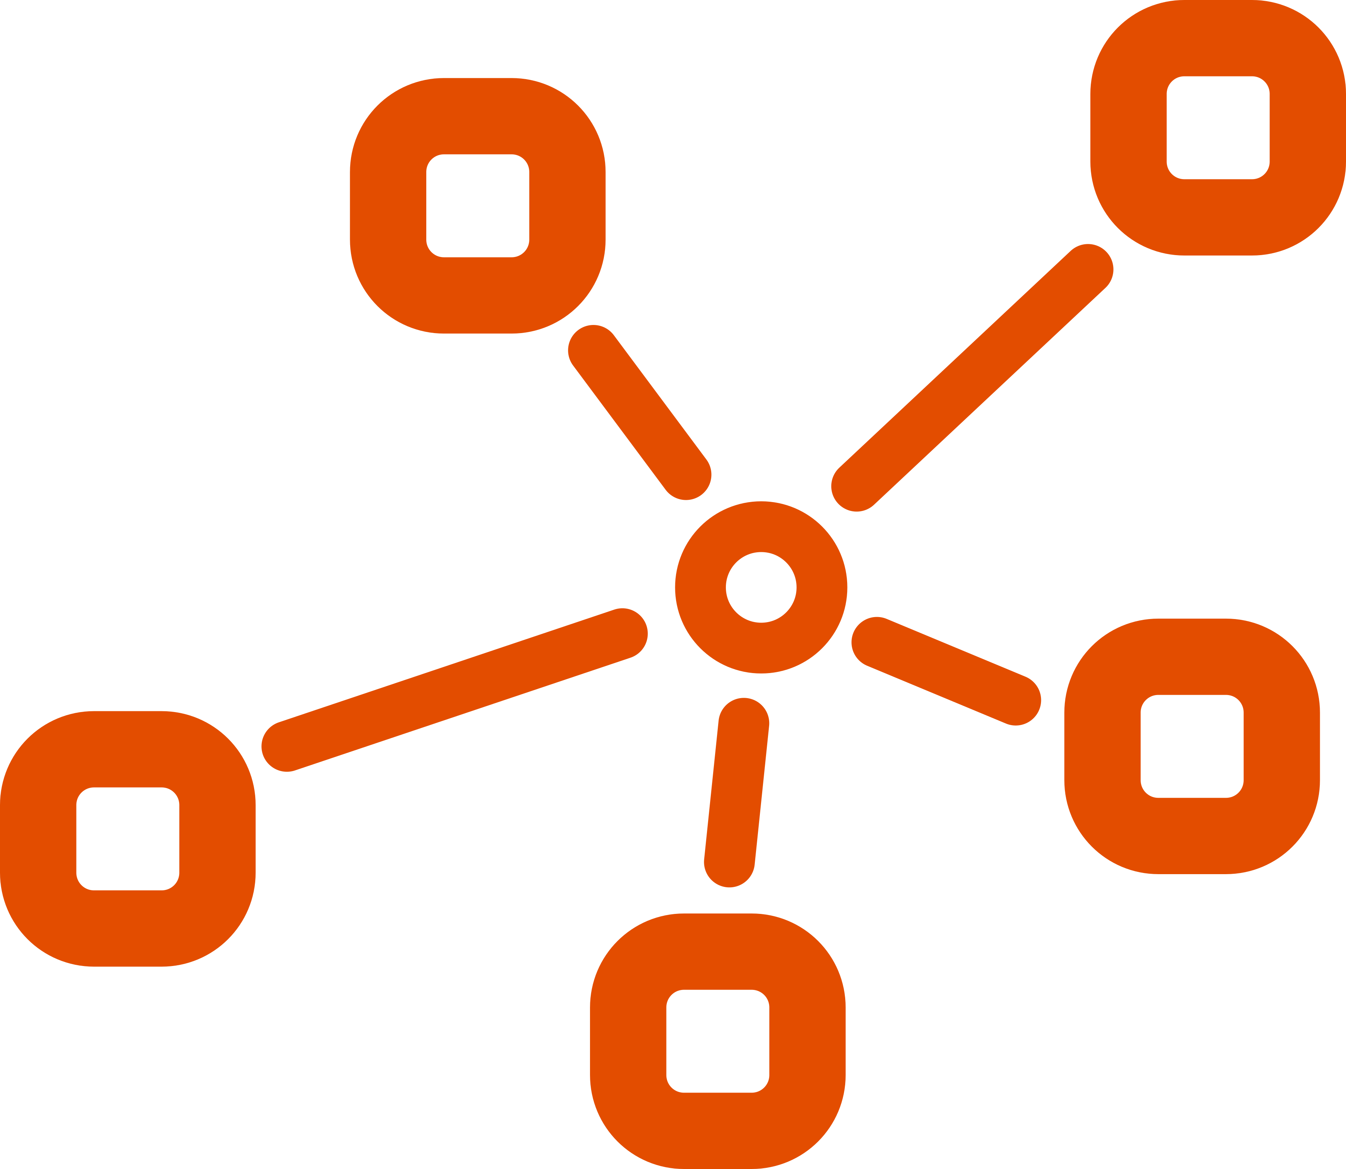
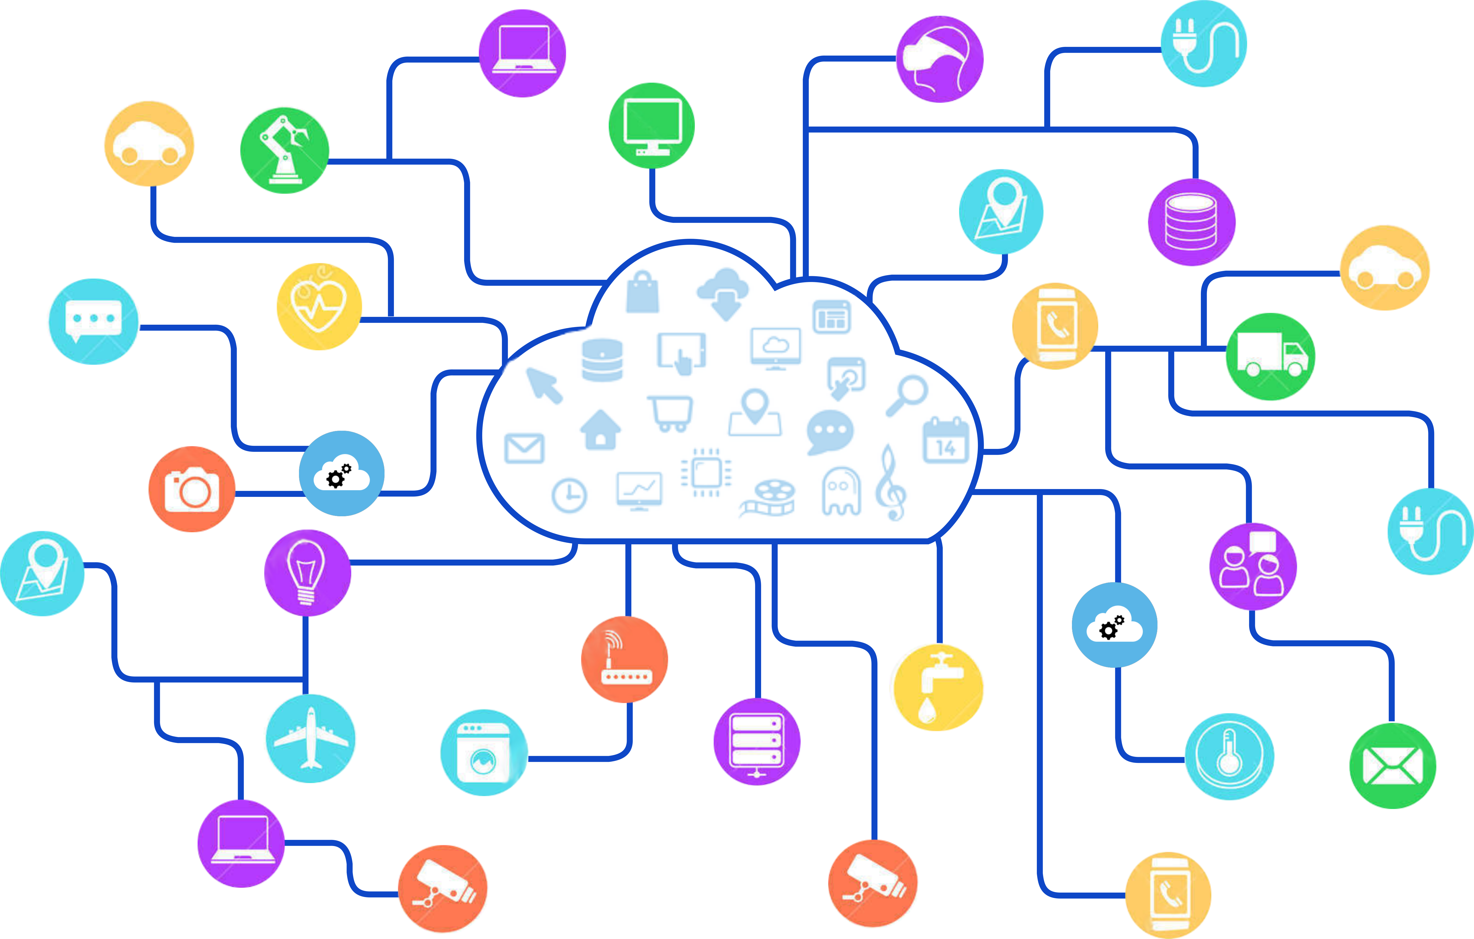


The Internet of Services
Service-Oriented
Architectures
XaaS
Notes:
Future services will be created with unprecedented degrees of freedom in their dimensions: digital infrastructures, software technologies, and data. They will be implemented using distributed frameworks and patterns, designed to facilitate integration, deployment and management.
Convergence among existing software paradigms, such as cloud computing, software-defined networking, and the Internet of Things (IoT) is expected to this purpose,
leveraging autonomicity and dynamic composition through service-oriented and everything-as-a-service models applied to cyber-physical systems.
As a matter of fact, micro-services, web services, service-oriented architectures, programming models, distributed middleware, and software orchestration are already present in latest frameworks and market technologies for both the software, CPS, and telecommunication industries. In Europe, the FIWARE initiative has led to the definition of open and royalty-free APIs for development and deployment, while the International Data Spaces association is now working on a more complete architecture for the Industrial Data Space [2]. ETSI has defined a complete architecture for network function virtualization, which is expected to be largely adopted by upcoming 5G infrastructures. TOSCA is currently the de-facto standard for describing the structure of cloud applications.
CEF Digital, the digital arm of the Connecting European Facility, is funding investment in digital building blocks, which are basic capabilities that can be reused in any project to facilitate the delivery of digital public services across borders and sectors [3]; the combination of CEF building blocks covers the whole process of data collection and treatment and will be used in the European Data Value Chain.

Slide 21
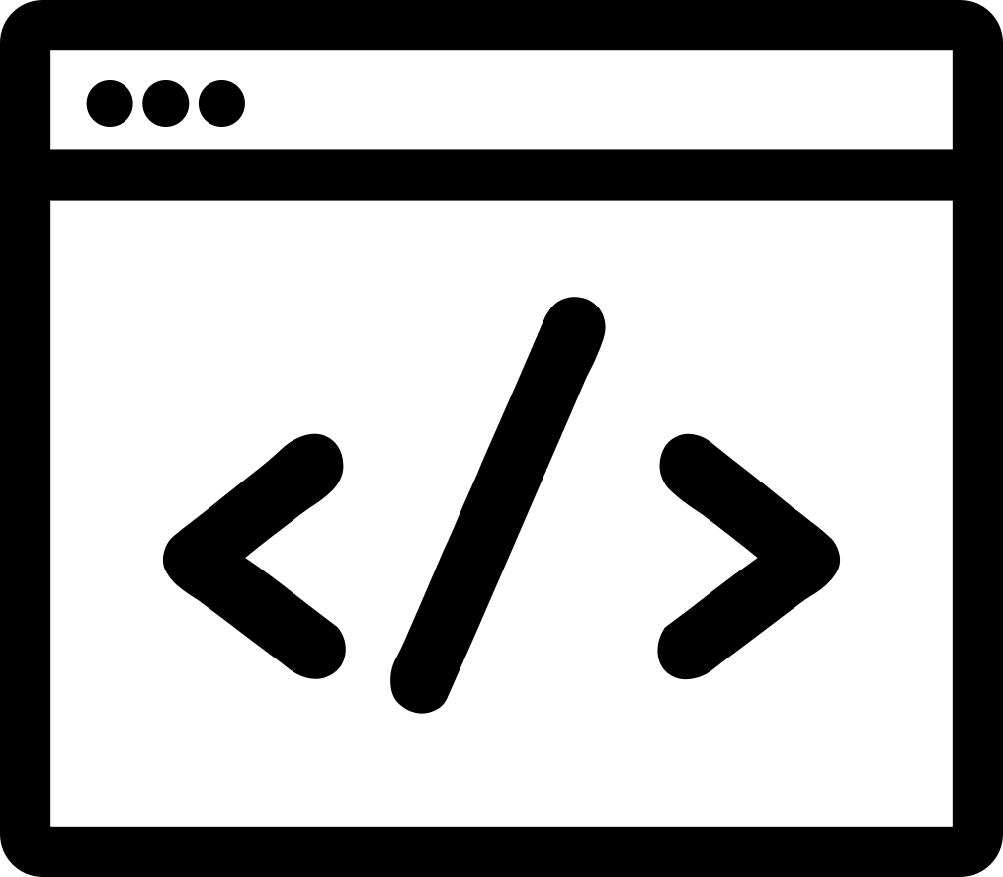


Chaining services
Dom. C
Dom. D
Dom. A
Dom. B
Notes:
From a technical perspective, the creation of a business chain consists in the logical interconnection (not necessarily with a strictly linear pattern) of several processes, software, and devices, and feeding them with relevant user’s data and context across multiple technological and administrative domains.
Let’s consider, for example, an industrial supply chain that encompasses manufacturing, transportation, and assembly.
Many business models are today shaped around just-in-time models and tight scheduling of all industrial and handling processes, so to ensure regularity of supply and to avoid the need for large storage of components and products.
This requires capillary control over all stages and sharing information, events and data among the different actors involved in the chain. Moreover, one of the most valuable keys to boost innovations and new revenue streams is unprecedented service agility, which means digital services and business chains are expected to emerge and dissolve much faster than traditional value creating networks.

Slide 22
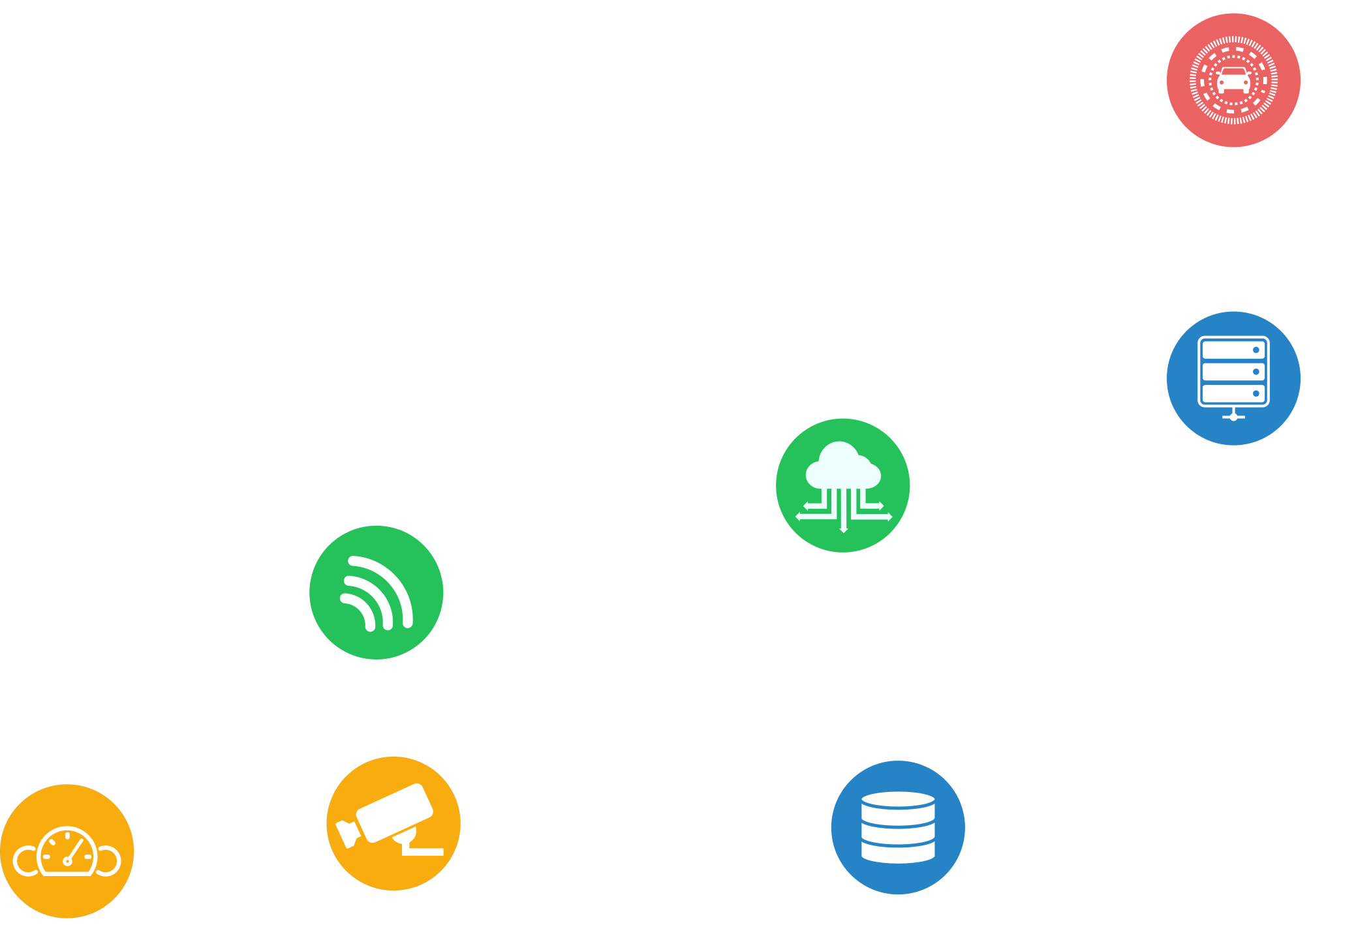
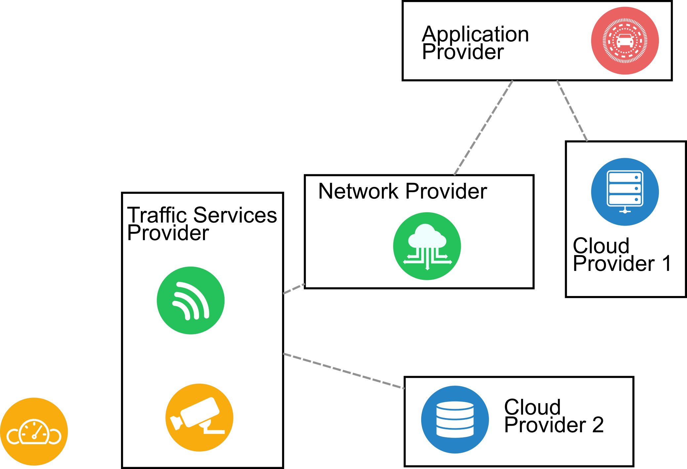
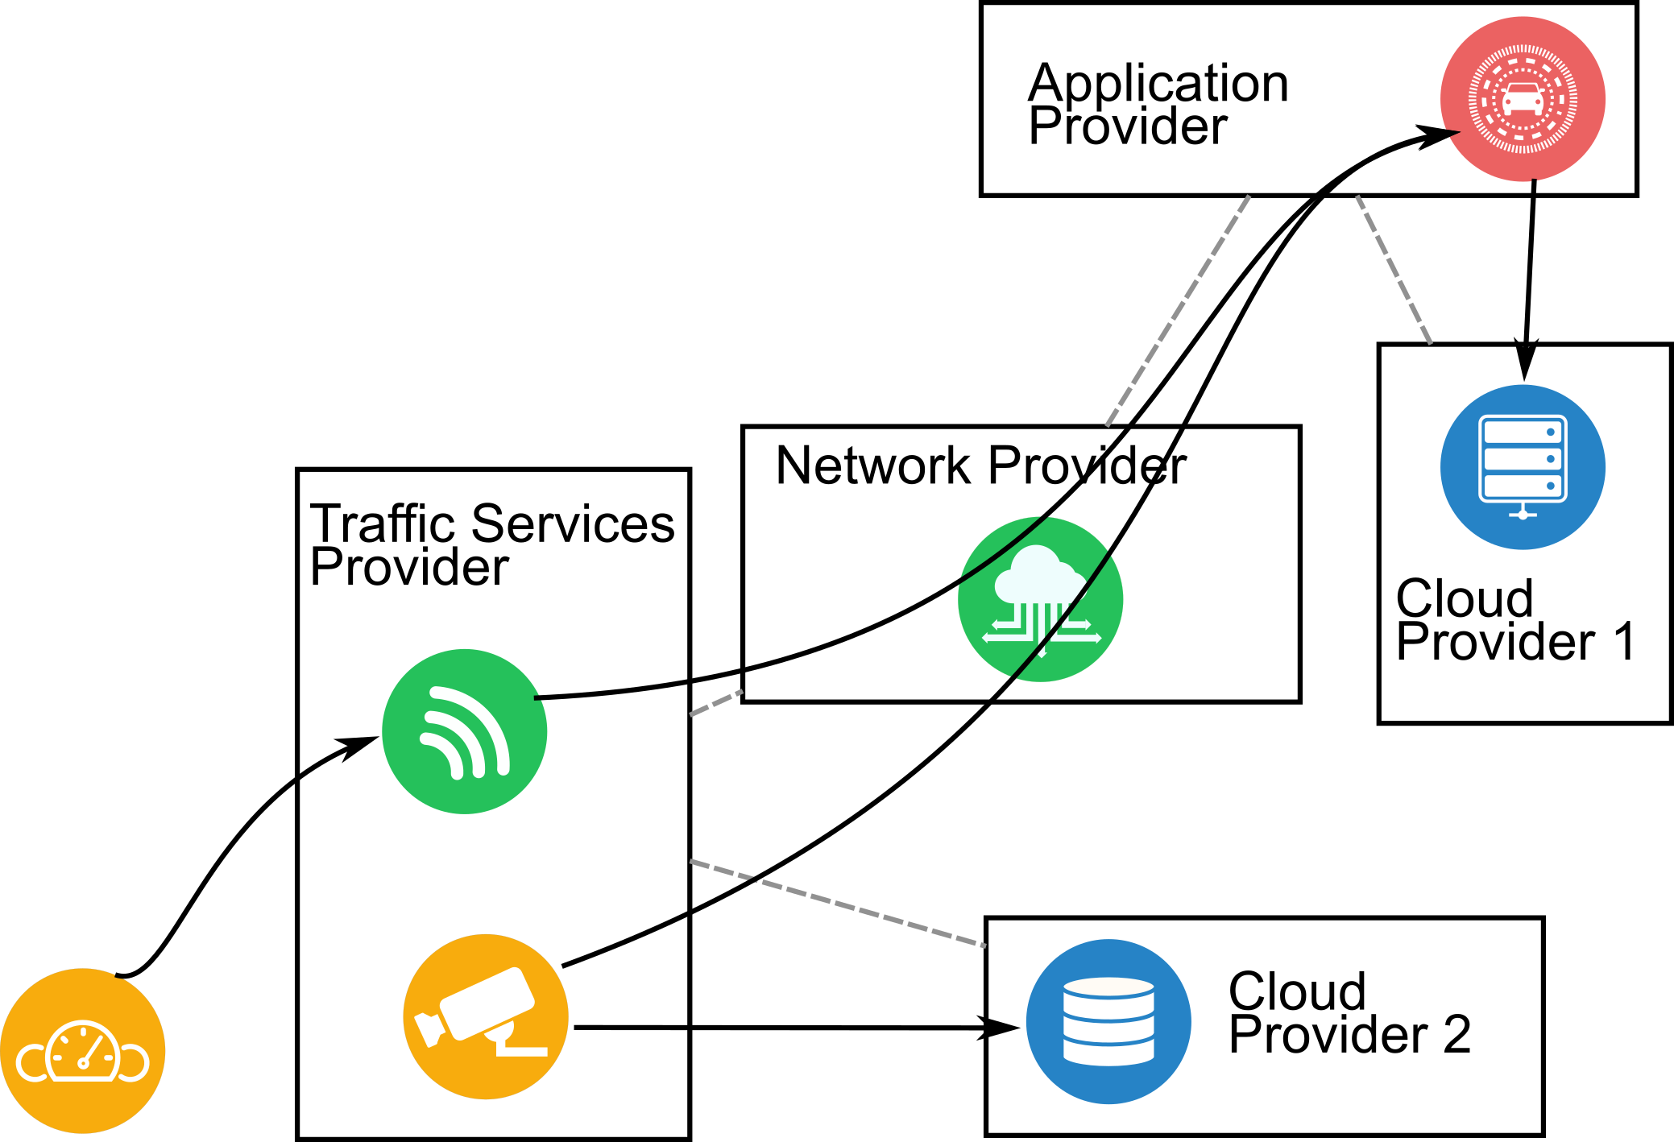
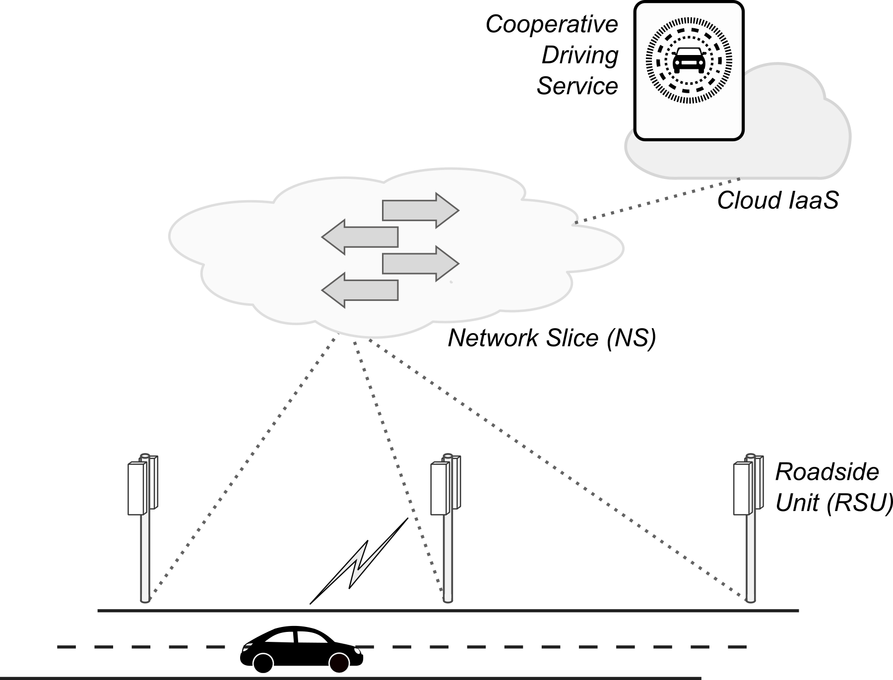
Chaining services: example
Notes:
A simple example of digital business chains crossing multiple administrative domains can be given for the automotive domain. A cooperative driving system may be implemented that collects information from vehicles through Road Side Units operated by Traffic Services Providers, then carries it over a 5G network slice, and finally processes it in a cooperative driving application deployed in the cloud. In addition, data from other subsystems (like cameras and weather forecasts) can be available from other cloud services.

Slide 23
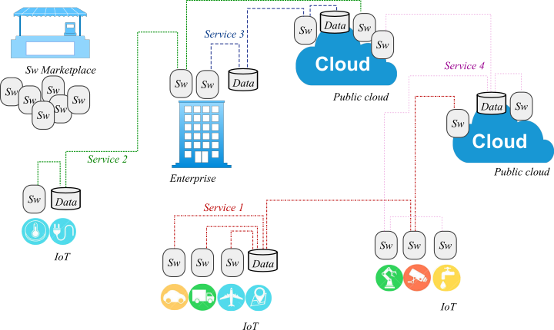
Digital business chains
Dynamic composition of
software
services
data
smart devices
Elastic topologies
model-driven or data-driven
Programmable infrastructure
cloud, SDN, IoT

Slide 24


… and security?
Service meshes
Virtualization
IoT
Cloud
Fog/edge computing
Dynamicity
Autonomicity
Agility
Multi-tenancy
Heterogeneity
Multi-domain
Security perimeter
Rigidity
Inefficiency

Slide 25
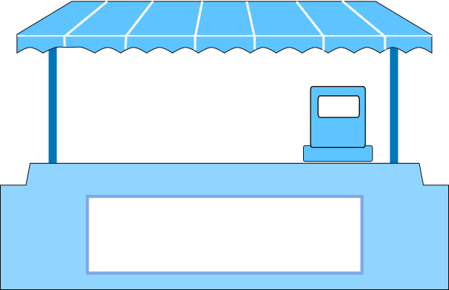


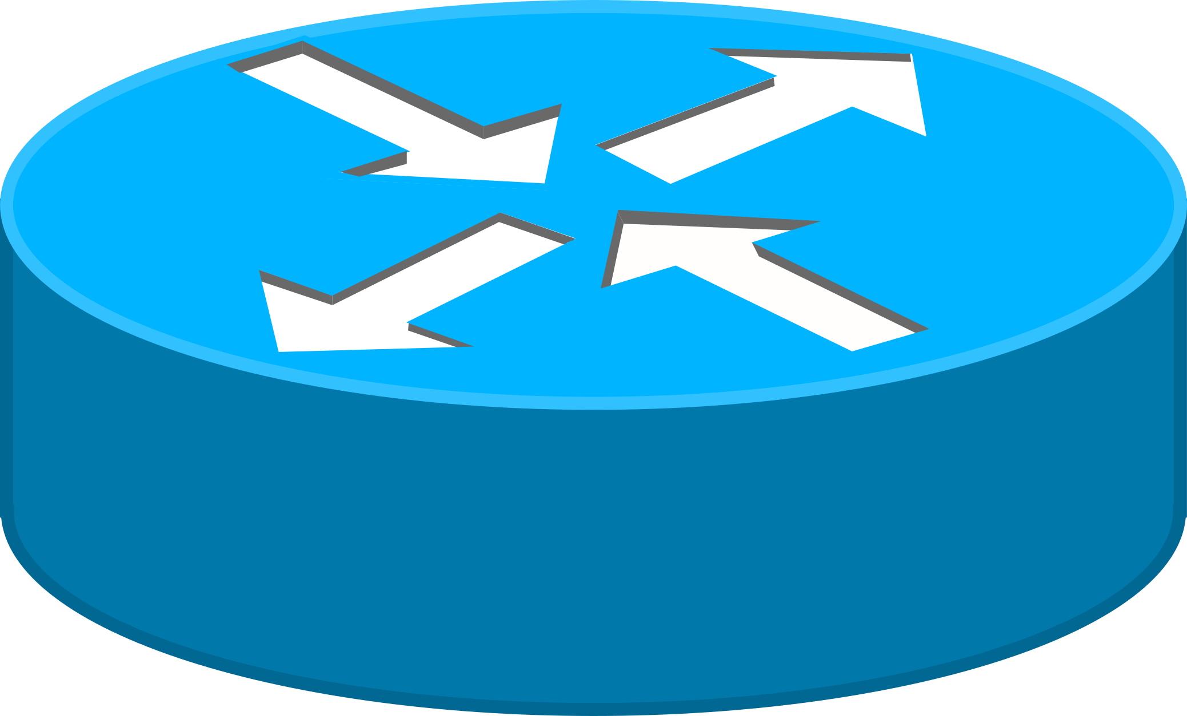
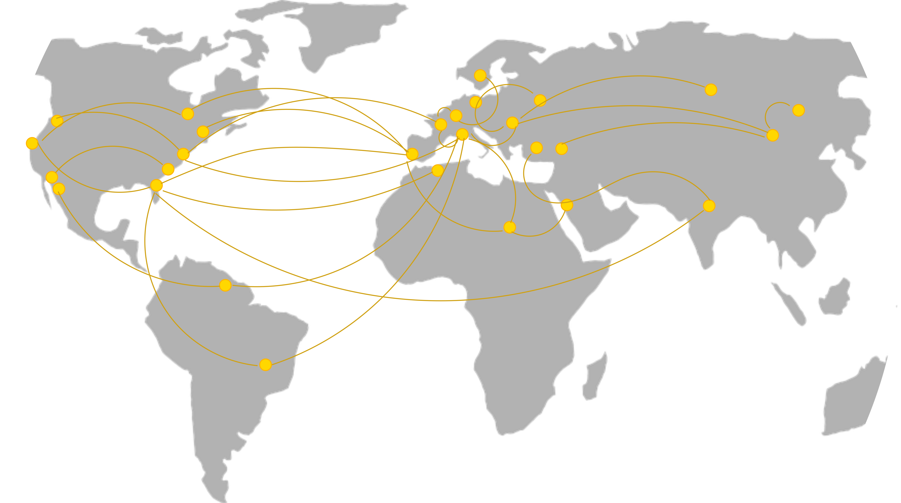




Security concerns

Slide 26
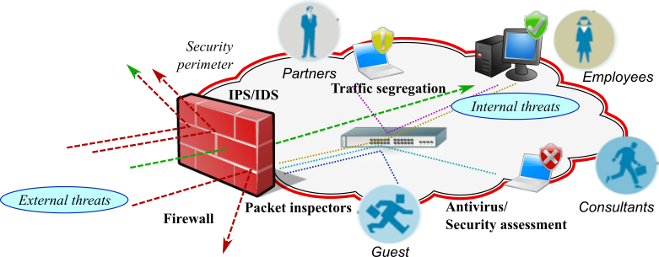
The “security perimeter” model
Shortcomings:
rigidity
network partitioning
HW/SW security appliances
routing/switching policies
market segmentation
network packets bounced across security appliances
for analysis, inspection, mitigation, and processing
redundant inspection/analysis
limited scope security service

Slide 27
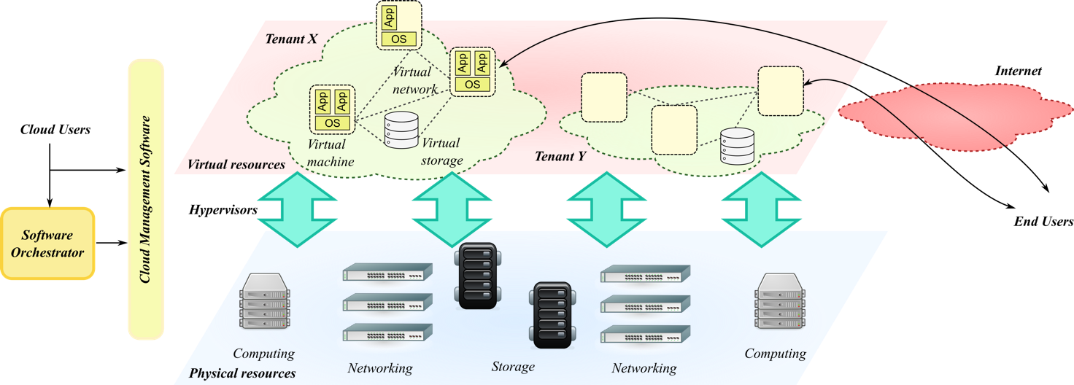
Security threats: cloud infrastructures
Internet to guest (OS and applications)
Privilege escalation
Cross-VM information leakage
Lack of encryption in management networks (storage, migration)
VLAN hopping
Software weakness (vSwitch)
MAC flooding
ARP Spoofing
STP attacks
DHCP spoofing/starvation
Extra-privileges
Guest escape
Host escape (Xen)
Management interface
DoS from guests
Guest escape
Arbitrary code execution
Arbitrary file write
Internet to host

Slide 28
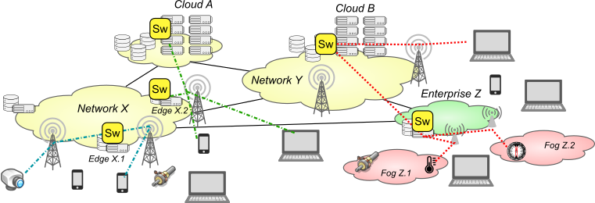
Security threats: 5G infrastructures
Broader range of attack models Increased attack surface
Multi-tenancy
Lack of hardware acceleration
Lack of trusted platform modules
Public Internet connection (LTE, WiFi) Weak security mechanisms by design Poor configuration
Tampering
Resource exhaustion
Personal and portable devices, multihoming
Road warriors
Removable storage Outsourcing
Critical infrastructures, data and information leakage
Physical access
Resource exhaustion Lack of expertise/number of installations
Dynamic service composition (NFV, MEC) Intrusion and privilege escalation
Notes:
New architectures and usage models, which leverage virtualization and the Internet of Things (IoT) paradigms, are now revealing the substantial inadequacy of legacy security appliances to effectively protect distributed and heterogeneous systems (including cloud, edge, and fog installations) against cyber-threats. As a matter of fact, the prevalent paradigm in enterprise security is still the “security perimeter” model, which assumes safe isolation of ICT assets by physical or virtual network segmentation, hence concentrating protection at the perimeter only. Running virtual machines in public cloud/edge installations, as well as integration with third party’s devices and smart things, blur the boundary between public zones and private domains, hence making hard to apply the security perimeter model in a trustworthy and effective way. Since valuable ICT assets cannot be easily enclosed within a trusted physical sandbox anymore, there is an increasing need for a new generation of pervasive and capillary cyber-security paradigms over distributed, multi-domain, and geographically-scattered systems.
Read Section 2 [FGCS]

Slide 29
Security challenges
Slow and ineffective detection of attacks
low visibility, limited scope of algorithms
Difficulty in identifying new threats and vulnerabilities
ineffective correlation of data from multiple sources, lack of big data techniques
Outdated and inefficient architectures
sharing the security context, balance granularity with overhead
Technology and business lock-in
no common interfaces/architectures
Notes:
slow and ineffective detection of attacks, due to partial and incoherent security information, non-interoperable algorithms targeting specific cyber-attacks only (e.g., network or server DDoS, intrusion detection/prevention, malware identification);
difficulty in identifying new threats and vulnerabilities, because of limited information and data available, ineffective correlation of data from multiple sources, lack of big data and machine-learning techniques;
outdated and inefficient architectures for sharing security context, which can combine the need for fine-grained knowledge with efficient resource usage. In fact, effective detection of attacks and identification of new threats may need detailed logs, events, and measurements for processing and correlation, but this would result in excessive overhead for both network and storage systems;
technology and business lock-in by the adoption of verticals with tightly integrated network/cyber-security solutions, often from a single vendor.

Slide 30
Security challenges
Rigidity
network partitioning, security processes, routing and switching policies
Slowness to share the knowledge
mostly based on paperwork and manual processes
Ineffective awareness to users
dashboards mainly designed for technical operators (no end users, management, legal staff)
Notes:
intrinsic rigidity, due to the difficulty to change architecture and system configuration: network partitioning, deployment of hardware or software security appliances (including the necessary agents), routing and switching policies in case of traffic diversion towards scrubbing centres;
slowness and inertia to share the knowledge of new threats and attacks, due to heavy involvement of humans in the loop and the need for manual operations, and to lack of common representation formats;
ineffective interaction with users: though security dashboards are continuously evolving and enhancing user-friendliness, they are usually reserved to technical staff and do not integrate seamlessly in other administrative and management processes (e.g., risk assessment, legal and normative requirements).

Slide 31
Security challenges
Growing complexity
human errors in design, implementation, configuration, and management
Trustworthiness and reliability of the overall end-to-end service
integrity and dependability of the whole chain beyond identity management and access control
tracking the propagation of private data and sensitive information
weak links represent a privileged attack vector
Dynamic composition
the chain topology and composition are usually unknown
difficulty to assess and certify trustworthiness for multi-domain and multi-tenancy services

Slide 32
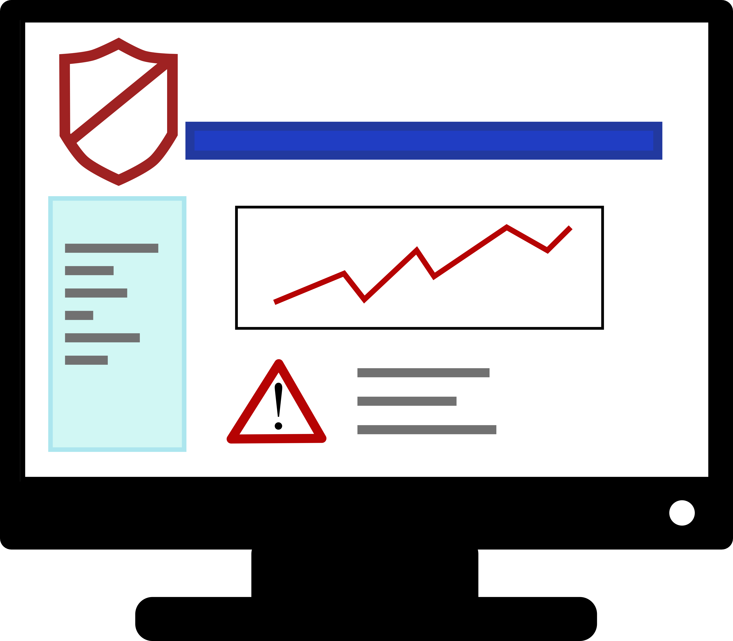
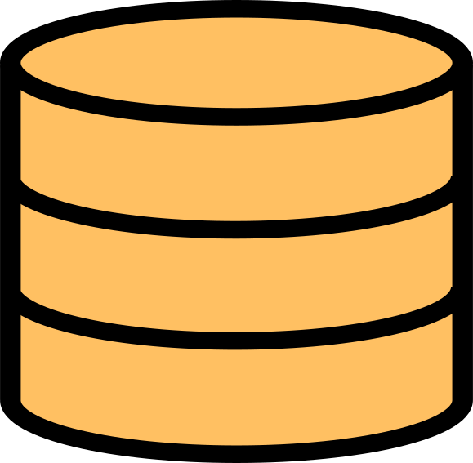
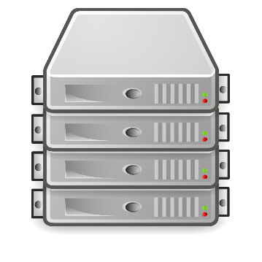
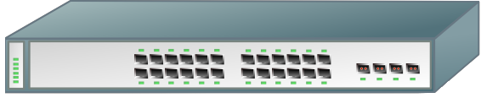
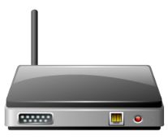
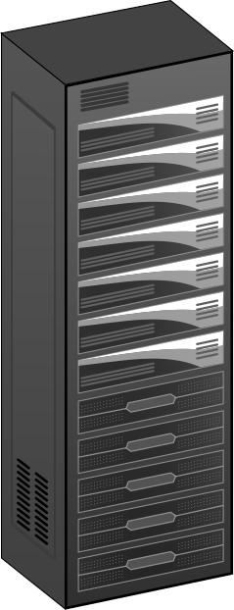


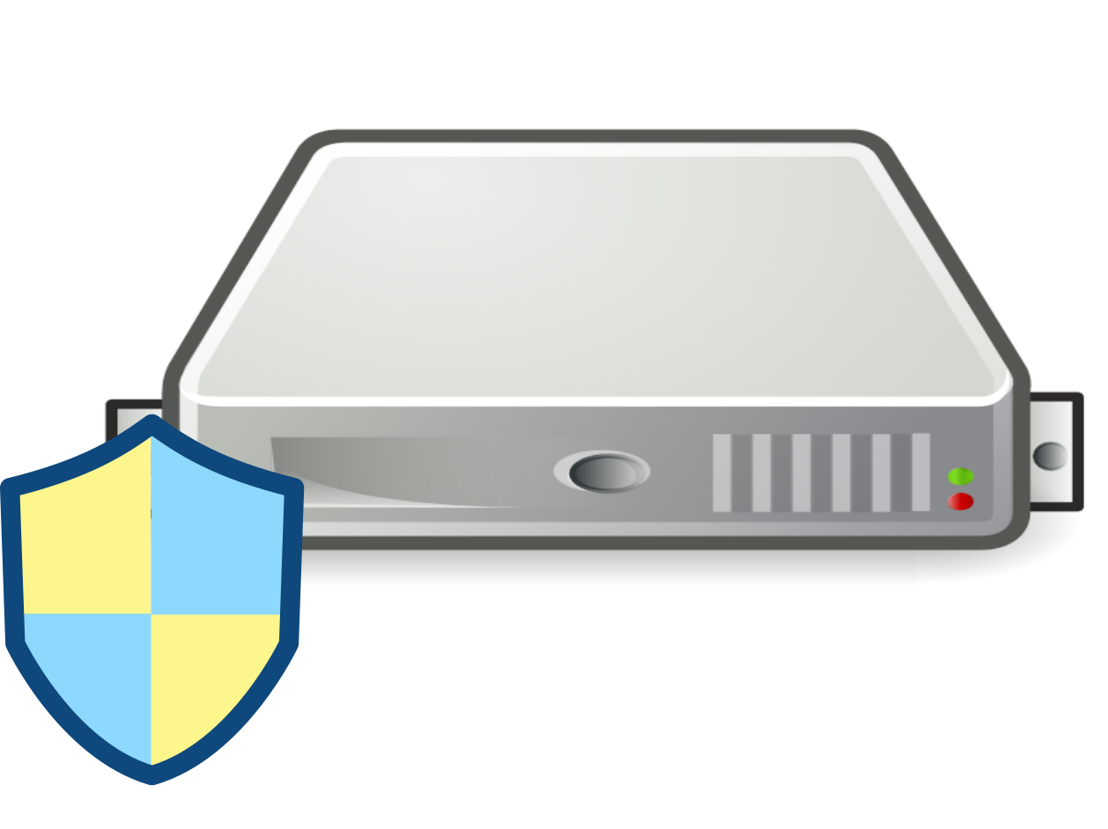




Emerging trends
Network visibility/
Endpoint protection/
SIEM
Cloud protection
From centralized to distributed architectures
Leveraging the programmability of the infrastructure
Efficiency vs performance
Reliability and data protection
Orchestration and automation
Data correlation
Visualization, representation, and sharing
Embedded, industrial, IoT devices
IDS/IPS
Firewall
Antivirus
Antivirus
Firewall
IDS/IPS
VPN
Firewall
Antivirus
IDS/IPS
Notes:
1. The current market of cyber-security products is largely fragmented. In addition to legacy firewalls, intrusion prevention/detection systems and antivirus for personal and enterprise usage, many vendors are already tackling new business opportunities by delivering solutions for enterprise’s networks and endpoints, pure and hybrid cloud, industrial devices and networks, security analytics, and integrated solutions.
Network visibility and segmentation - Inspect network traffic (sometimes encrypted traffic analytics are available). Use sensors or flow-monitoring protocols (NetFlow, sFlow, IPFIX, J-Flow, NetStream). Support for enterprise, industrial, cloud networks. AI and machine learning technologies. 3D visualization of network topology. Network segmentation (Cisco only). Closed solution (vendor lock-in). Single domain solution. No mechanisms for tracing user data. DDoS protection, anomaly detection, malware detection, zero-day exploit. Investigation and query-based filtering.
Endpoint protection - Centralized analysis and detection based on Machine Learning and threat intelligence. Protection of applications, devices, web. GDPR-compliant. Vulnerability assessment and automatic patching. Mono-domain.
Cloud protection - Support private (VMware, KVM, Xen) and public clouds (AWS, Google, Azure) Use public cloud APIs, agentless deployment by providing services in relevant marketplaces. Integrate private and public clouds. Integrate analysis with enterprise’s networks. Segmentation and access control. Mono-tenant.
Embedded, industrial, and IoT devices - Efficient design for low-end hardware. Default Deny for Apps, Drivers and Libraries. Antivirus On-Demand. File Integrity Monitoring and Log Audit. Tackle specific security concerns for embedded systems: geographical dispersion, rare updates. Secure every industrial layer, including SCADA servers, HMI, engineering workstations, PLCs, network connections. Mono-domain.
SIEM/Security Analytics - Get real-time visibility into all activity on systems, networks, databases, and applications. Apply artificial intelligence, machine learning to wide data sets. Aggregate intelligence across multiple control points. Correlate threat events. Provides in-depth threat visibility across IT environments in one place. Quick one-touch remediation actions. Big data capabilities. Some concerns from users about logging sensitive data or events. Advanced search and forensic analysis.
One of the main weakness in current approaches is presence of multiple discrete appliances with specific detection scopes. This has two main drawbacks:
Every security appliance analyses data and events from the protected environment, often replicating part of inspection and monitoring tasks (for example, network traffic may be analysed by both a network visibility tool and IDS);
The correlation of data and events from different contexts/layers is rather difficult. For example, network visibility tools often face the challenge of encrypted communication, without the possibility to correlate statistics with logs from applications that generate the traffic. Integration of statistics collected by network devices, logs and inspection on VPN servers, and logs from application will greatly improve the possibility of correlation and identification of known attacks and new threats.
Secure composition and operation of dynamic business chains require some steps forward with respect to existing leading-edge technologies. Several challenges have already been identified for emerging computing and network paradigms [1], including the need to combine fine-grained and precise information with efficient processing, elasticity with robustness, autonomy with interactivity. In addition, digital business chains raise unique trust concerns, especially related to partially unknown and fast-changing topologies.
There is an increasing need for new forms of pervasive and capillary traffic monitoring and inspection techniques to tackle network threats, which can correlate events in both time and space dimensions and could provide timely operational information to feed novel disruptive approaches capable of estimating the risk in real-time.
Next generation frameworks for situational awareness are expected to combine fine-grained and precise information with efficient processing, elasticity with robustness, autonomy with interactivity. State of Art of commercial products and research efforts shows some general trends and specific challenges in this respect: the shift from centralized to distributed architectures, the programmability of the infrastructure, the chase to efficiency and performance, the need for robustness and data protection, dynamic adaptation to changing environments and conditions through orchestration, correlation of data in time and space, and suitable representation to humans.
From centralized to distributed architectures
With the increasing integration of cloud, edge, and fog resources in critical business and industrial processes, the security perimeter becomes elastic (since it grows and shrinks according to resource usage) and usually encompasses external devices, software, and infrastructures. The firewall (or similar appliance) at the network boundary inspects incoming and outgoing traffic but does not protect against internal threats. The need to evolve towards distributed and capillary architectures has resulted in commercial micro- and distributed firewalls.
The concept of ‘distributed firewall’ has been recently proposed for virtualization environments, to integrate packet inspection and filtering in hypervisors [14], witnessing the importance of pervasive and capillary control. Distributed firewalls for virtualization environments and cloud computing build on the concept of micro-segmentation [15], and deploy packet inspection rules in hypervisors, while keeping centralized control. They enable very fine-grained control over security policies, beyond mere IP-based structure [14].
This approach is currently used for enforcing filtering rules but does not have the flexibility to provide deep inspection capability tailored to the specific needs for detecting threats and on-going at- tacks. More flexibility is required that leverages infrastructure programmability to perform inspection and monitoring actions well beyond static packet matching available in current commercial products. A major limitation of virtual firewalls is that they cannot provide the same guarantees of private enterprise networks: external resources lie in third parties’ infrastructures where trust mechanisms are still missing (i.e., the behaviour of physical hardware and networks cannot be controlled by cloud users).
A shift to more distributed architectures is therefore on-going to tackle the elastic nature of the enterprise’s perimeter, but coordination is still mostly missing. There is a strong need for multi-layer architectures, which enable modular composition of cyber-security systems by including multiple heterogeneous domains, and the application of coordinated and synergic actions under a common policy framework.
Leveraging the programmability of the infrastructure
In recent years, a great effort has been undertaken to increase the programmability of communication networks [16]. This allows fine-grained control over forwarding operation, relying on dumb network equipment and its logically centralized smart controller. Networks are indeed the pervasive infrastructure that connects all devices and smart things, hence they represent the ideal mean for capillary monitoring, inspection, and enforcement.
The combination of packet processing in network devices and computing hypervisors allows a great flexibility in where traffic is analysed and inspected, in both physical and virtual environments.
Recently, the interest has started shifting from stateless to stateful operation in network switches, which provides far more programming flexibility and efficient processing in the data plane, while reducing the overhead in the control plane. This would eventually allow more advanced programming models, well beyond static forwarding rules and flow-level reporting available today, which include inspection and detection on flows and/or packets, aggregation and even storing capabilities.
It is worth pointing out that enhanced programmability also brings more dynamicity in running detection and monitoring tasks. This means that lightweight processing could be used for normal operation, while reverting to deeper inspection at the early stage of any suspicious anomaly (or upon signalling from some knowledge-sharing framework), with clear benefits on the overall processing load. Further, a distributed and capillary architecture, with inspection capability in each network device and hypervisor, automatically addresses scalability, since the processing resources grow with the system size. This increases efficiency and boost better performance, especially when attacks are complex to detect.
Efficiency vs performance
The increased security has led to the elaboration of more complex attacks, which eventually turns into more difficult detection. In addition, the ever growing number and complexity of protocols and applications makes their traffic and behaviour increasingly difficult to understand and to model, which complicates the detection of anomalies [11]. Accordingly, inspection is evolving from simple memory-less string matching to stateful rules (such as regular expressions). As immediate consequence, more processing power (hence CPU cycles) are required to check packets and instructions against more elaborated rules. Therefore in-line detection is likely to overwhelm software-based implementations of load balancers, firewalls, and intrusion prevention systems, especially in case of large volumetric attacks [27]. It is therefore necessary to consider extensions or re-designs that adopt hardware and in-kernel acceleration (e.g., GPU, Intel DPDK, FD.io, Snabb switch, IOVisor, XDP, BESS) to build fast data paths that process packets at nearly line speed.
Reliability and data protection
Trustworthy of the processed information, events, and knowledge is of paramount importance, since an inappropriate response may be more damaging than the original attack. Any loss of integrity in the infrastructural components (i.e., hardware tampering) or control protocols may result in inaccurate, inappropriate, manipulated, or poisoned context information, which gives a forged situational awareness and eventually leads to ineffective, late, or even counterproductive reactions.
Encryption and integrity services are almost always available in control channels, as well as user authentication and access control, but no certification of origin and time of information is usually available. Authentication, authorization, and access control are already present in SDN controllers (e.g., OpenDayLight uses a token-based mechanism). However, trustworthy and integrity of the collected information are also fundamental requirements for maintaining historical evidence with legal validity, to be used for example in forensics investigations. At the same time, privacy issues must be tackled in order to not disclose any personal and sensible information without explicit consent, even to technical and management staff, apart in case of criminal investigation. Specific challenges include collecting and conserving events and traffic patterns in a confidential way, anonymising data before analyses, and making them accessible in clear form only in case of legally authorized investigation.
Orchestration and automation
The progressive introduction of more programmable devices brings more flexibility and dynamicity in processing, but also requires a control plane that exposes device capability, and an orchestration plane that automates the process of on-the-fly building and deploying the configuration/code. In the transition from centralized to distributed architectures for cyber-security systems, it is indisputable that orchestration will play a crucial role in shaping the behaviour of the capillary programmable infrastructure, i.e., to delegate filtering and pre-processing tasks to programmable resources, including network switches, hypervisors, and smart things, with tight coordination with the deployment and life-time management of software. Through orchestration, the granularity, detail, and periodicity of collected information can be tuned dynamically according to specific needs (e.g., increase granularity in a specific area where anomalies have been detected).
Orchestration automates life-cycle operations, such as deployment, scaling, resilience, but must act according to specific intention and needs of users. Many recent orchestrators use policies to drive the orchestration process. Policy-based security management is an administrative approach for simplifying access control and security management of networks, services, etc. Policies are sets of operating rules, usually in the form ‘on event, if condition, then action,’ that reflect the resource owner’s intention of adequately protecting valuable resources. Policies are typically specified separately to the system implementation to allow them to be easily modified without altering the system.
Data correlation
The dynamicity, sophistication, and speed of attacks require autonomous response to provide timely and effective countermeasures. Sharing and correlating events and anomalies within the same and among different domains is also essential in order to (even proactively) anticipate any emerging or upcoming threat already (partially) detected somewhere. In-deep analytics are required to detect and identify threats from elementary and apparently uncorrelated events. Some tools are already available to this purpose (e.g., the ECOSSIAN platform and the Caesair model).
Pervasive and fine-grained monitoring of ICT installations will produce an impressive amount of data, even if programmability is used to tune the deep of inspection according to the actual need. Big data and machine learning capabilities are required to extract relevant knowledge from the cluttered flow of information, by correlating data from pervasive data sources. The challenge is to add predictive and proactive capabilities to existing security tools and systems, in order to prevent attacks by analysing the environment, rather then merely react in case of compromise.
Existing algorithms already make use of flow-level information for network volume anomaly detection, though this only represents the crumbs of what may be available tomorrow. New algorithms for vulnerability analysis and threat detection may be based on the ideas of the Attack Graphs, Attack Surface analysis, Kill Chain definitions and Attack trees models with the support of the deep learning techniques, petri nets, and game theory models. Correlation should also include automatic selection of the algorithms for the analysis of the threats based on the threat potential negative impact, both environment-dependent and environment-independent.
Visualization, representation, and sharing
Once the proper knowledge has been built by correlating and understanding data and events, it must be used in the most appropriate manner for reaction and mitigation. Situation awareness must be represented to security staff, must feed smart reaction tools (including service orchestrators), and must be shared in order to boost synergic and coordinated response.
Next-generation visualization tools and interfaces shall include concrete models and specifications for an innovative approach in the field of cyber-security, being able to capture novel aspects entailed by virtualization paradigms (including fog architectures and the IoT), also bearing in mind the need for distributed, pervasive and capillary monitoring techniques. This means that situational awareness shall be related to the system topology and composition through proper data visualization, with clear indication of the main vulnerabilities, flaws, threats, and their position.
Existing tools for visualization should be improved with real-time cross-domain information, in order to reach a better response time and to reach the scope of situational awareness. Visualizations must be able to provide enough information to prepare effective response strategies, but shall also avoid to reveal sensitive information about other domains (e.g., vulnerabilities, lack of proper defence tools, undergoing attacks, etc.), as well as include proper identification and verification of credentials of authorized users, to avoid propagating useful information to attackers.

Slide 33
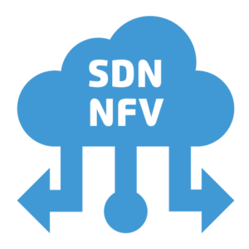
Emerging trends
From centralized to more distributed architectures
Micro-firewalls, distributed firewalls;
Log collectors, integrated security solutions, SIEM.
Leverage network programmability
From SNMP, NetFlow, sFlow, IPFIX to OpenFlow and NetConf;
From stateless to stateful inspection and monitoring.
Notes:
We argue that, in relation to network threats, most of the rigidity of current security paradigms comes from two main factors: i) the need for physical isolation of enterprise’s assets from the outside world, and ii) the presence of multiple standalone appliances placed at exchange points, each dealing with specific security aspects (e.g., firewalling, intrusion detection/prevention, virtual private networking, antivirus, deep packet inspection). Current challenges and emerging trends are all suggesting that such paradigms should evolve from discrete appliances into pervasive and capillary systems, which decouple distributed context monitoring from (logically) centralized detection logic, somehow aligning to the same evolutionary path already undertaken by software-defined networking.
Read Sec. 3 [FGCS]
SIEM: Security Information Event and Management
IPFIX: Internet Protocol Flow Information Export
NetFlow is a network protocol developed by Cisco for collecting IP traffic information and monitoring network traffic.
sFlow, short for "sampled flow", is an industry standard for packet export at Layer 2.
NETCONF is a protocol defined by the IETF to “install, manipulate, and delete the configuration of network devices”.

Slide 34


Emerging trends
Boost efficiency and performance
from simple memory-less string matching to stateful rules;
applications are the main targets for attacks;
growing number and complexity of protocols;
multi-vector attacks.
Trustworthiness and data protection
certification of origin and integrity
data location and propagation

Slide 35
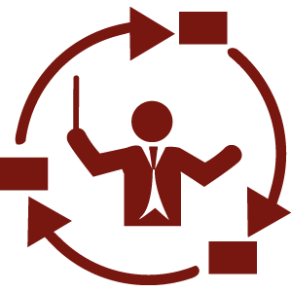


Emerging trends
Software orchestration
smart devices and applications with programmable reporting capabilities;
policy-driven automation;
formal verification methods.
Data correlation
machine learning and AI;
information sharing.
Situational awareness
visualization, representation, sharing.

Slide 36
The cloudification wave
The “cloudification” wave
massive virtualization
multi-tenancy
externalization
DevOps
software orchestration
elastic services
cloud-native applications

Slide 37
Security aspects for cloud-based services
Service integrity
timely detect any attack or threat that may compromise the integrity, confidentiality, or availability of data and processes.
Service trustworthiness
trust software developers, things, vendors, service providers, infrastructures, data sources, …
Data sovereignty
know who, how, and where will process private data and sensitive information.

Slide 38



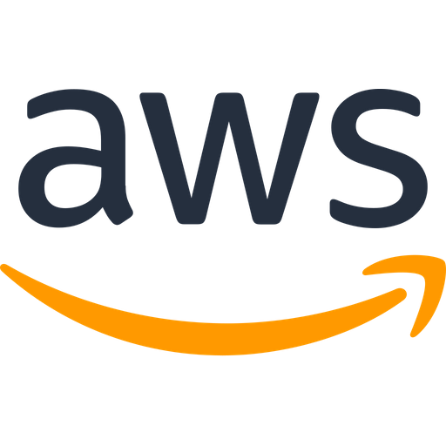
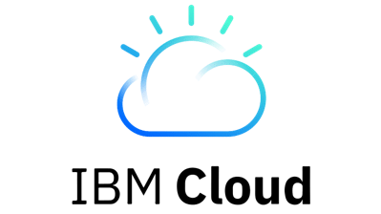

Challenges
Infrastructure vs Virtual Resources
many providers and different cloud models
different responsibilities
heterogeneous interfaces
ever-evolving attack patterns
broad threat landscape
dynamic topologies
visibility
software, configuration, communications

Slide 39
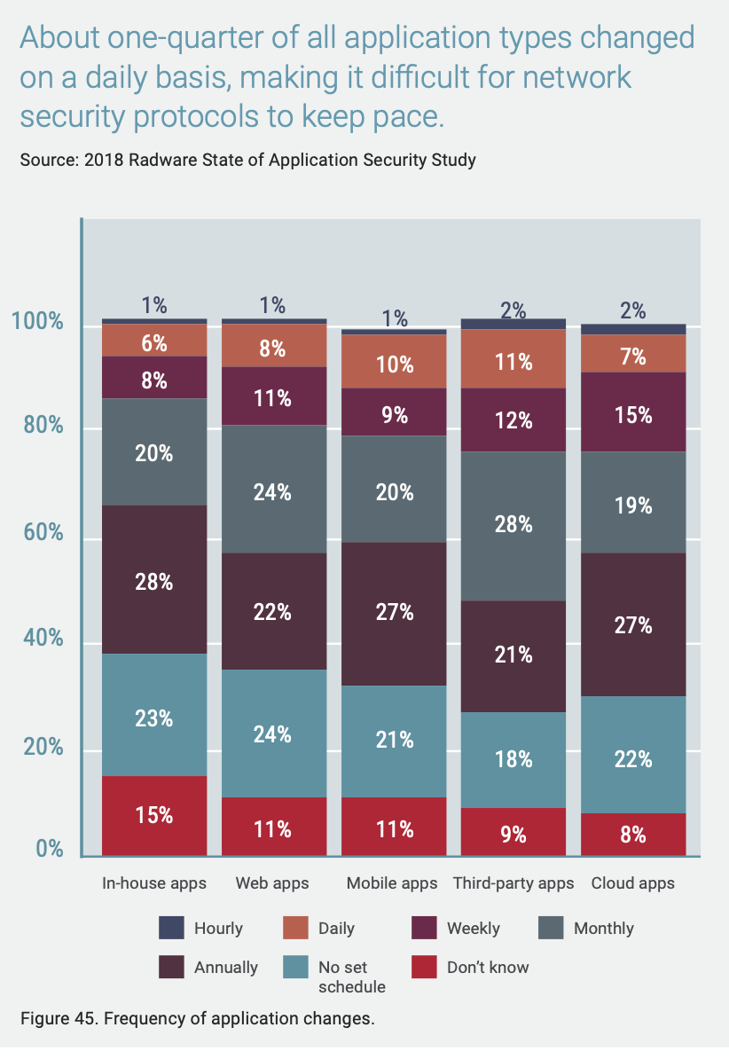
Technical issues: faster software releases
Faster release cycles of applications
new computing paradigms improve the speed at which new software is delivered;
this complicates security analysis, which has not improved at the same pace.
Frequency of application changes

Slide 40
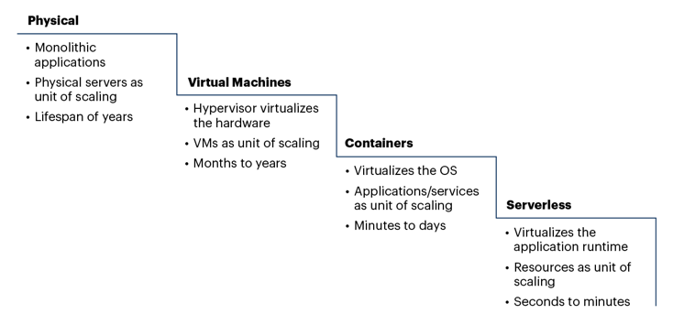
Technical trends: evolution of workloads
Increased shift to cloud-native applications
Kubernetes being the prevailing cloud technology

Slide 41
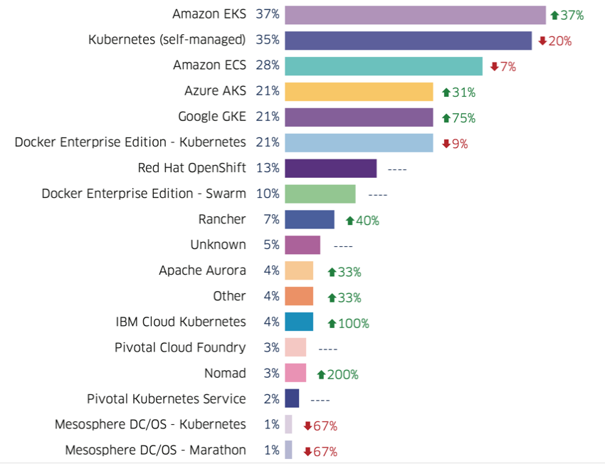
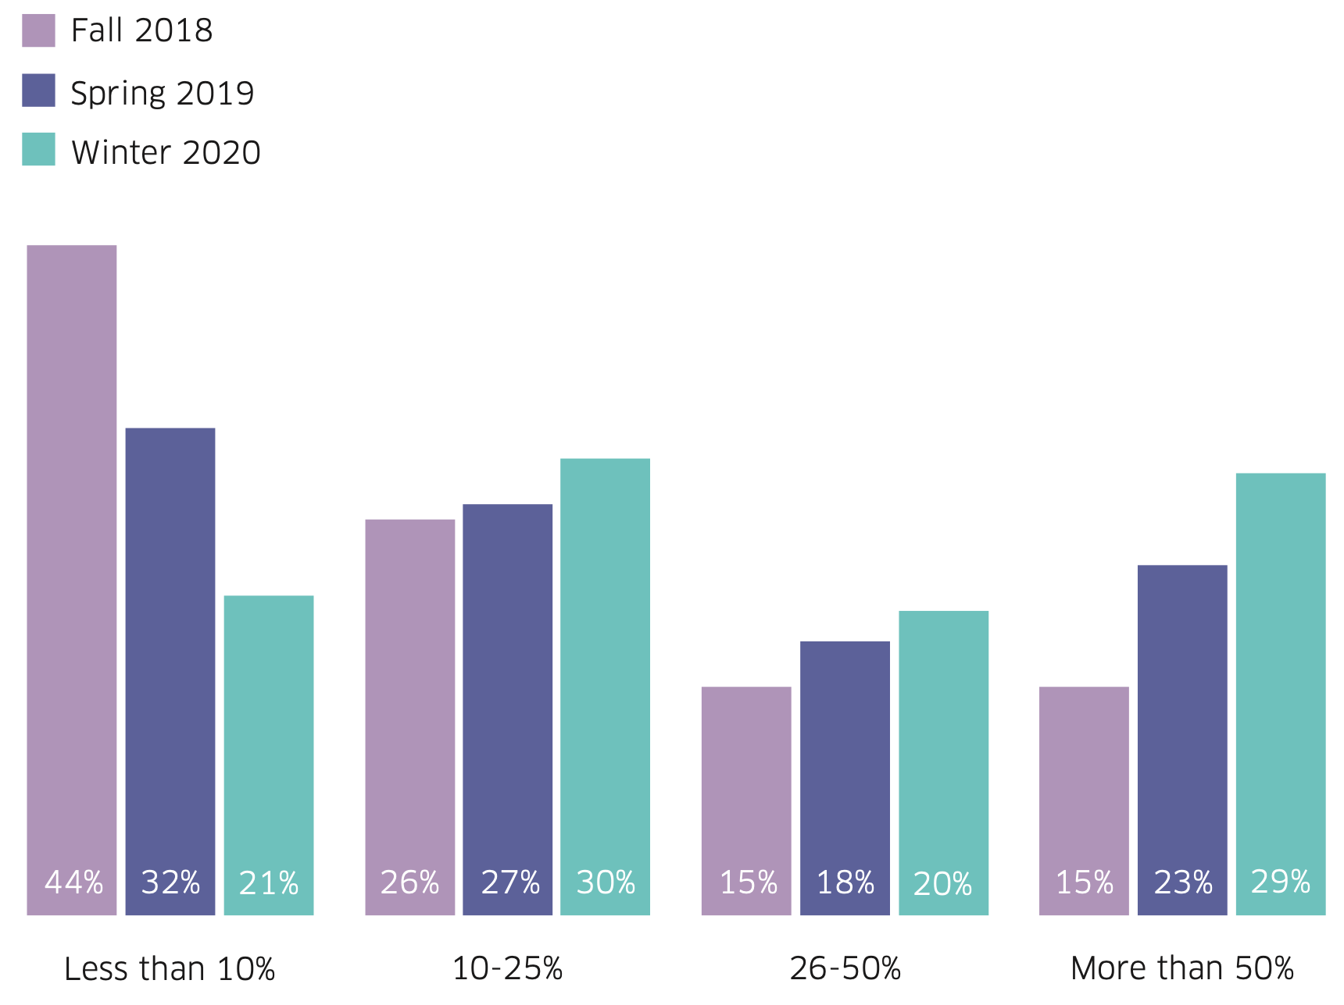
Technical trends: containers and Kubernetes
Increased shift to cloud-native applications
Kubernetes being the prevailing cloud technology
Percentage of containerized applications
Usage of container orchestrators

Slide 42
Technical trends: multi-cloud deployments
No vendor lock-in
Increased availability and resilience
Geographical coverage
performance, regulations
Heterogeneous interfaces and capabilities
deployment, management, security
Notes:
5G infrastructures

Slide 43
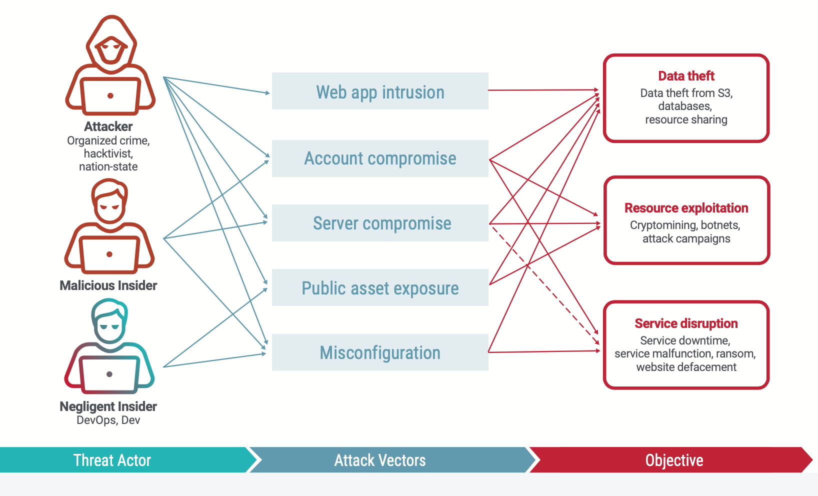
The cloud threat model

Slide 44
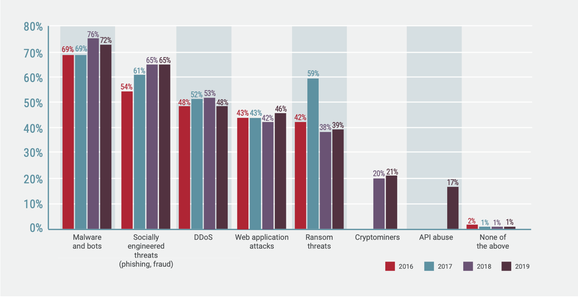
The cloud threat landscape
Notes:
The introduction of micro-services and service mesh architecture will boost attacks against APIs, and protecting east-west traffic flows inside the network will become a larger concern than defending north-south traffic flows from external entities

Slide 45
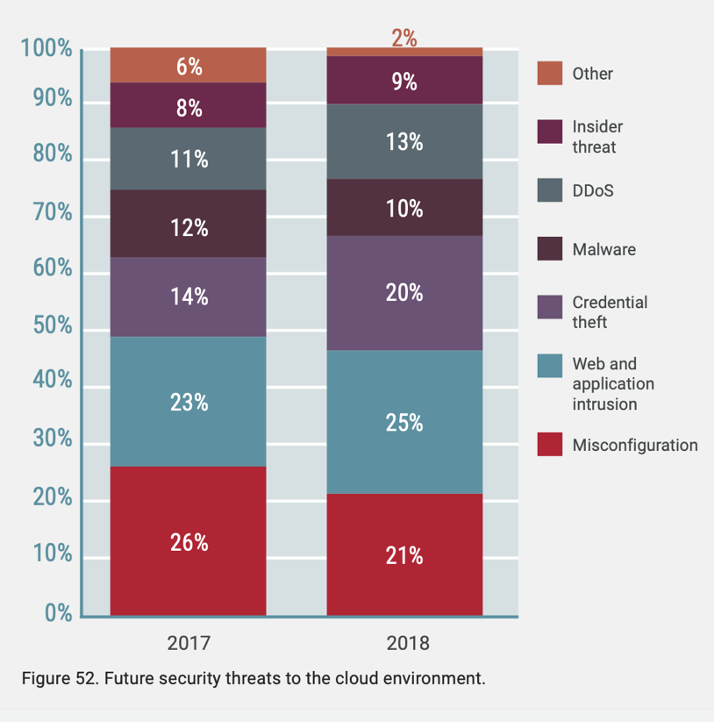
Top cloud threats
Many security tools and features available for cloud applications
incorrect usage is a common issue.
Typical causes:
low understanding;
limited visibility;
fast software release cycles
multi-cloud deployments and heterogeneous security capabilities.
Notes:
All cyber-security reports agree that misconfiguration are the most common cause of breaches. In the case of cloud applications, cloud providers offer identity access management tools to control access to applications, services and databases. However, the responsibility apply security policies is left to the customers, by defining a set of rules that control what entities can be accessed and how (e.g., valid invocation of API on a resource). If such policies are not properly managed, hackers have one simple entry point to access the entire network. Another common mistake is the usage of pre-defined permission templates, which apply to multiple scenarios. In this case, the one-fit-all approach is likely to result into wider permissions than needed.
There are several causes that lead to misconfigurations. In some cases, there is simply a low understanding of the features offered by the cloud, or lack of visibility into the cloud environment and resources. Another problem comes from agility and CI/CD paradigms, which make continuously release new versions of applications and services, while DevSecOps are not able to keep the pace. The quick innovation cycle in products and processes also makes it difficult to find and train human staff in the proper way. The trend towards the multi-cloud approach does not help in this direction, since it increases the knowledge base for managing multiple heterogeneous solutions.
Improving the current practice should look in two directions. First, more automation should be used in deriving and verifying security policies, so to remove part of the dependency on human skills. Then, a continuous analysis of usual behaviour of each entity, just to ensure users only have access to what they need, nothing more. In both cases, the concrete target to effectively reach the goal is smart configuration hardening that applies the approach of “least privilege”.

Slide 46

Top security features

Slide 47

Cloud protection
Multiple layers, multiple scopes.
Multiple layers, multiple tools.
Multiple layers, multiple responsibilities.
Multiple layers, many cross-relationships.
Notes:
Protecting the Perimeter: This is the basic, foundational level of security that any cloud security operator should take on first. Technologies such as Amazon Web Services provide virtual private clouds (VPCs) and security groups provide simplistic ways to protect the perimeter, such as allowing only IPs that need to be allowed, etc. Visibility into Workloads: The next step after VPCs is to understand the behaviour of workloads. This is paramount before initiating any kind of security mechanism or technology. Knowing the baseline behaviour of various types of systems will expose where irregularities can occur. Workload data includes:
Users who regularly log in and their expected activities
Processes running and forking on the system
Normal/expected in- and outbound network connections
Activity involving critical files on the system
Integration of Workload Behaviour with Infrastructure Services: Once perimeter security is in place and visibility into workloads is achieved, integrating infrastructure services in order to monitor behaviour changes gives the cloud operator further improved visibility. For instance, this integration will monitor:
If a user’s behaviour on a workload is authorized by identity and access management (IAM) permissions
If the running of a workload is authorized by cloud identity services
If anything running on the infrastructure should not be there (like a web server) or anything is talking to it from outside of established boundaries
Integrate Workload Behaviour with External Information Sources: help the cloud operator know when abnormal workload behaviour is actually the action of a known external behaviour. For instance:
If the abnormal IP that a workload connects to is part of a botnet
If the abnormal socket opened on a workload is typical of a command and control channel
Integrate Workload Behaviour with Community: Understanding what behaviours and threats are common to an industry arms the cloud operator with even more information in identifying attack behaviours. For instance, finding out if anyone else within the community has also observed an abnormal process fork activity may mean the difference of identifying a threat or a shared abnormality.

Slide 48

Understanding the sharing of responsibility
Notes:
The matrix decomposes ICT services in multiple logical layers, adopted from the Cloud Security Alliance [19], and shows how responsibility is split for different business models. Multiple business models are taken into account that could be used by SPs. The legacy approach is to buy and operate the whole infrastructure, including things (IoT) and ICT installations (DC). Financial and operational sustainability suggest limited usage of this model, e.g., to implement critical services, while additional resources will be acquired on-demand by `as-a-Service’ paradigms, as already introduced in Sec. 3.3. We recall that smart things can be included in either PaaS or DaaS models, when they are not fully managed by the SP (i.e., IoT case).
The nomenclature for the logical layers is borrowed from the cloud, even if the Project scope is not strictly limited to that domain. The Infrastructure layer includes the hardware: servers, disk arrays, network equipment, sensors, actuators and any other device that can be involved in the realization of cyber-physical system. Typical management operations at this layer include purchase, installation, electricity supply, cooling, upgrade, maintenance, disposal. Direct ownership of physical infrastructure is a big issue for small and medium enterprises, due to the high capital investment, the quick obsolescence of the hardware, the delay to deploy new resources, the difficulty to foresee the right amount of resources to effectively cope with workload fluctuations. The metastructure layer is the glue between the infrastructure and the applications. It includes protocols and mechanisms for management and configuration, which allow provisioning of virtual resources. It may be limited to simple interfaces in case applications are directly deployed on the server; for example, IPMI for servers and OpenFlow/Netflow for network devices. Alternatively, hypervisors, cloud management software and orchestrators can be used for full-fledged virtualization environment; some common technologies and tools are Xen, KVM/QEMU, OpenStack, VMware vSphere, ETSI MANO, Juju, OSM. The applistructure layer defines the main business logic and the underlying artefacts to create the software environment. The structure of applications changes significantly for different business models. For bare metal installations, it only includes the OS, system libraries, and application software. For IaaS it should also identify the abstract resources (VMs or containers, number of CPUs, amount of RAM, disk space, NICs, network links) that are required to create the virtual environment to run the software. For PaaS, it also features message queues, artificial intelligence analysis, or notification services and whatever else is needed to build the platform; in this case, the boundary between the scope of the InP and the SP is not fixed, but depends on each specific offer (i.e., some features may be integrated in the platform or the user can select them at provisioning time). Finally, the infostructure layer concerns data and information managed and stored in the service. In most cases, this layer is under full control of the service provider, which business logic collects, processes, stores, and delivers data on behalf of end users; however, in case of DaaS, providing data is the main business for the RP. This does not necessarily mean that the same RP implements the full stack: indeed, as already introduced in the previous Sections, virtual resources might be provided by different RPs in a composite way. For example, data from RP1 may be hosted in a database service provided by RP2, which in turn runs in a VM created in the infrastructure of RP3. The pictorial representation in Figure 5 does not capture this distinction, because the main aspect is the sharing of responsibility between the SP and RP(s).
As general indication, the responsibility of each actor maps to the degree of control it has over the architecture stack:
In the DaaS model, the RP is responsible for providing reliable and safe data to authorized customers. The responsibility may be partially shared with other RPs, if the data is hosted on third party’s infrastructure.
In the SaaS model, the RP is responsible for nearly all security aspects, including operation of the infrastructure and the hosted software. The responsibility for the SP is mostly limited to identity management and access control. Serverless models remove the day-to-day responsibility for updates from the cloud users, but also require to work with providers with strong track records. This model should foster cloud providers to maintain extremely high security levels, since this is necessary to building their reputation and credibility. The usage of HTTP and similar REST interfaces also removes the need for layer-2 network virtualization, hence shrinking the typical attack surface to API calls and/or HTTP(S) traffic.
In the PaaS model, the RP manages all security aspects related to the platform, which includes the infrastructure and software facilities (like databases, domain name servers, operating systems, compilers, analytic services, etc.). The SP is responsible for everything he implements and runs on the platform (e.g., data processing, connection to his own things). However, there are some common security services (like logging, monitoring, auditing) that lie in between, since they may concern elements operated by both actors. The risk in this case is unnecessary duplication of similar security frameworks and components.
In the IaaS model, the RP is only responsible for the physical infrastructure, while the SP takes on the responsibility for everything he deploys and operates in the virtualized resources. Also in this case, there are intertwined security aspects.
In the IoT/DC models, only the SP is responsible for all layers, including tampering, eavesdropping, and any unauthorized physical access to devices. In this case, the SP has the best visibility on the evolving context, including information from hardware, logs and events from applications, statistics from network appliances. However, the whole management burden and financial investment may be cumbersome for smaller businesses.

Slide 49
















Cloud protection approaches
Reported vulnerabilities by year
Internet
Criticality
Notes:
From the perspective of cybersecurity, the usage of virtualization technologies fosters multi-tenancy and weakens the isolation between users and their applications, making traditional paradigms largely ineffective. Indeed, common security paradigms for the enterprise are based on the deployment of discrete security appliances that build a security perimeter that encloses all valuable ICT assets. Firewalls, IPS/IDS, and antivirus are commonly used today, often integrated in enterprise-wide tools that give visibility over the network and devices.
When public cloud services are used, applications are deployed out of the safe enterprise perimeter and get more exposed to security threats. As a matter of fact, adversary can also be present in the applications of other tenants, in bogus or unreliable (deceptive?) service providers, as well as in the physical environment for IoT devices.
The security perimeter becomes virtual in these environments, leveraging software technologies as hypervisors and virtual switches to isolate tenants from external and internal threats. Unfortunately, hypervisors were mainly conceived for safe and independent execution, they often consist of small and lightweight code, and do not implement strong security services. Indeed, many vulnerabilities and weakness have been already identified during the years. In any case, hypervisors provide isolation between tenants, but does not protect from external threats.
So, what options are available for protecting virtual services today? Option no. 1: use security services from cloud providers and Cloud Management Software. Just take a look at the commercial offers of cloud providers (i.e., AWS), and you’ll discover a great set of security features: firewalling, DDoS mitigation, encryption, antivirus, IDS, access logs, IAM (Identity and Access Management), and so on, but don’t be amazed if you don’t find your old, beloved security appliances… If you run a standalone cloud application, this solution might be perfect for you, but what about if you needed to integrate your application together with other enterprise processes or if it were part of an orchestrated service? The main problem here is that heterogeneous security services are provided by different cloud providers, with different control models and interfaces, and this means security cannot be managed in a consistent way across multiple providers. The I2NSF framework from IETS is already advocating the convergence towards common interfaces (at least for NETWORK security functions), and the usage of a two-tier architecture that translates high-level user policies (even of non-technical nature) to low-level rules and configurations. In any case, the required security functions might not be available in some infrastructures.
Option no. 2: Riding the virtualization wave, several vendors are already delivering software instances of their security appliances, suitable to be deployed in cloud environments.
This help build a uniform and integrated solution across multiple sites, but comes at the cost of additional resource consumption (i.e., VMs or containers) and overhead. For this reason, this approach cannot be typically adopted for small and lightweight services, which represent the main application scenario for cloud orchestration. Even more so it cannot be typically adopted for IoT and other resource-constrained devices.
Bay the way, have you ever had a look at vulnerabilities reported for cyber-security appliances? You should be aware that security appliances themselves increase the attack surface of your cloud applications!

Slide 50

Cloud protection hierarchy
Cloud Workload Protection Platforms (CWPP)
provides “consistent visibility and control for physical machines, virtual machines, containers, and serverless workloads, regardless of location”
brings end-point protection concepts to the cloud, taking into account specific characteristics: multi-tenancy, elasticity, resource limitations
Cloud Security Posture Management (CSPM)
integrates security capabilities offered by cloud providers with the customer’s security processes
Cloud Access Security Brokers (CASB) - translate internal security policies to specific interfaces
Cloud infrastructure:
cloud providers
IDS, antivirus, firewalls and similar tools
as good as or better than most private DCs
Cloud Native Application Protection Platform (CNAPP)
leverages the synergy in combining CWPP and CSPM capabilities
scan workloads and configurations in development and protect workloads and configurations at runtime
Notes:
Based on the hierarchical model from Gartner, security solutions for the cloud can be roughly classified into two main classes:
Protection of the cloud infrastructure, which entirely falls under the responsibility of cloud providers (this includes IDS, antivirus, firewalls and other tools working at the hypervisor/virtualization layer).
Cloud Security Posture Management (CSPM), which integrates security capabilities offered by cloud providers with the customer’s security processes. Cloud access brokers fall under this category, building a homogeneous layer to translate the internal security policies to specific interfaces of each cloud provider; this usually includes access management, activity monitoring, data security, risk and data governance, activity analytics, etc.
Cloud Workload Protection Platforms (CWPP) which provide “consistent visibility and control for physical machines, virtual machines, containers, and serverless workloads, regardless of location.” [46] They brings the typical approach for endpoint protection to the cloud, but should take into account its specific characteristics (namely: multi-tenancy, elasticity, resource limitations).
It is important to avoid misunderstanding this description. Though the scope is similar to endpoint protection, CWPP implementation cannot simply remain a desktop-oriented offering that will run on a server. Instead, CWPP must be designed and optimized to support the typical use cases in an enterprise hybrid, multi-cloud architecture.
From an architectural perspective, CSPM is mostly intended to work at the management layer, while CWPP is specifically designed for the data plane (see Figure 16). Indeed, Gartner’s analysist pointed out that the optimal place for security visibility and control is from within the workload itself. Unfortunately, containers and serverless workloads are increasingly scanned for vulnerabilities and misconfigurations in development, but are deployed with little or no runtime protection within the workload and instead rely on external network instrumentation and event monitoring to detect threats. [45]. Multiple vendors are already leveraging the synergy in combining CWPP and CSPM capabilities, leading to the new category of Cloud Native Application Protection Platform (CNAPP) that that scan workloads and configurations in development and protect workloads and configurations at runtime.
The concepts of data, control, and management plane assume different meanings according to the specific where they are used. In this case, there is not any specific reference to the ASTRID architecture; rather the control/management plane refers to API available to control cloud management software, whereas the data plane is the customer’s software actually running into virtualized resources.
When considering the cloud segment, a publication from Gartner pointed out that the security posture of major cloud providers is already as good as or better than most enterprise data centres [45]. According to Gartner, the majority of successful cloud attacks can be ascribed to human errors, including misconfigurations, outdated software, mismanaged credentials. This means that the road to build secure cloud services goes through two main directions: i) leveraging existing security capabilities provided by cloud providers as part of their commercial offers; and ii) leveraging higher levels of automation available from cloud models.
The implementation of security processes for the cloud entails multiple layers, as shown in Figure 15. The layers at the bottom of the pyramid are the most important to reduce the risk; those in the upper layers builds of the foundation provided by the lower layers, but have less impact. The shared responsibility model implies that security of virtual machines and containers is the customer’s responsibility, not the cloud provider.
https://www.gartner.com/doc/reprints?id=1-1YAR7TFG&ct=200207&st=sb.
D1.2 provides a more detailed analysis of the responsibility boundaries for different cloud models (see Section 4.5.2).

Slide 51

Protecting the workload: the scope

Slide 52

The need for visibility
Cloud Security Posture Management (CSPM)
Cloud Workload Protection Platforms (CWPP)
Cloud infrastructure
Cloud Native Application Protection Platform (CNAPP)
(not shown)
Notes:
The objective impossibility to apply the legacy security perimeter model to emerging software architectures has boosted an increasing interest in the development of security and privacy solutions for the new paradigms. This effort has resulted in commercial and open-source security appliances for the cloud, including distributed firewalls, antivirus, intrusion detection systems, and identity/privacy management, often implemented in the hypervisor layer [12][13][14][15][16][17][18], as pictorially shown in Figure 3a.
Figure 3: The GUARD concept pursues a transition from infrastructure-centric to service-centric cybersecurity framework.
Given the current and evolving technological landscape, a growing trend is the transition from infrastructure-centric to service-centric cybersecurity frameworks (see Figure 3b). Virtual instances of security appliances have been available in the market since several years, mostly for data centres and virtualized IT environments, which simplify deployment and re-configuration [22][23][24][25][26]. Virtual security functions can be easily “plugged” into service graphs when the Infrastructure-as-a-Service model is used, leveraging the large correspondence with physical infrastructures that is present in this case. However, application to other cloud models is not straightforward, especially when some software components are shared among multiple tenants (i.e., Service-as-a-Service), they should run on resource-constrained devices (i.e., the fog or IoT), or the service topology changes over time (e.g., for scaling, discovery of new components, failures). In addition, given the lack of standard APIs and control interfaces, data collection, harmonization, and correlation may be very difficult [27][28].
The need for ever-more agility and adaptability to the evolving context at both the infrastructure and service layer is pushing towards self-adaptability in execution environments and self-awareness in programs. Fully-automated software and environments will evolve and morph during run-time to learning and cognition, without the explicit control of software engineers. The dark side effect of this evolution is the risk for large unpredictability, due to nondeterministic, opaque and partially inscrutable service topology. This raises question about the overall behaviour of the system, the location of personal and sensitive data, the sanity of the software, the availability of whole service, and, most of all, the ability to perform quick remediation and mitigation actions in case something goes wrong. Indeed, novel security and privacy lifecycle and process models are required, as agile development does not fit the sequential nature of traditional security engineering processes [4][10].
Following the above consideration, the basic principle behind GUARD is a service-centric framework, with security capabilities embedded into each software element, and orchestrated by a common security manager that (logically) centralizes the detection processes (see Figure 3c).
[GUARD]

Slide 53

Protecting the workload
Analysis of all possible operating conditions is largely unpractical (software is often not known).
Effective run-time missing, especially for serverless computing.
Software is re-used in different projects
Several tools available for SAST/DAST.
They do not fully cover container images.
API remains the most vulnerable point.
Static configuration.
Consolidated tools available.
Kubernetes offers a rich set of controls to effectively secure clusters and their applications.
Defaults are usually the least secure settings.
Network instrumentation, logs, and event monitoring.
Notes:
From an architectural perspective, CSPM is mostly intended to work at the management layer, while CWPP is specifically designed for the data plane (see Figure 16). Indeed, Gartner’s analysist pointed out that the optimal place for security visibility and control is from within the workload itself. Unfortunately, containers and serverless workloads are increasingly scanned for vulnerabilities and misconfigurations in development, but are deployed with little or no runtime protection within the workload and instead rely on external network instrumentation and event monitoring to detect threats. [45].
There are many tools available for static analysis security testing (SAST), which scale well and can be run repeatedly (as with nightly builds or continuous integration). They can find common programming errors with high confidence (e.g., buffer overflows, SQL injection), and provide very useful output to developers, including source files, line numbers, and even subsections of lines that are affected. However, this does not guarantee that a specific program is free from flaws or bugs. Indeed, SAST tools only detect a relatively small percentage of application security flaws (often limited to top ranked OWASP vulnerabilities [17]), often generate a large number of false positives, and do not cover authentication problems, access control issues, insecure use of cryptography, configuration issues, etc.
Dynamic analysis security testing (DAST) examines an application from the outside in its running state, much like what an attacker would do. Some techniques leverage the knowledge of the source code to generate all possible execution paths (i.e., concolic testing), but this approach is impractical in case of non-deterministic behaviour (for instance, when random or unpredictable inputs/conditions are evaluated) and large symbolic representations that lead to state explosion. Alternatively, fuzzers can be used to test programs that take structured inputs. The integration of different tools enables a good coverage of most vulnerabilities and flaws that can be found in the source code.

Slide 54

Protecting the workload

Slide 55

Security Information and Event Management
Collection of events and logs from many sources
preferably in raw formats to fulfil legal requirements for forensics.
Decisions based on rules
look for known patterns in the reported data.
Incident generation
logs, reports, or alerts.
Notification to humans
including remediation, if possible.

Slide 56

SIEM – Known limitations
Make the system programmable:
programmatic visibility
+
dynamic security pipelines

Slide 57
SIEM – Evolution
Analytics-driven SIEM
beyond plain correlation rules for data analysis;
sophisticated quantitative methods to gain insight into and prioritize efforts;
ML and AI for anomaly detection.
Flexibility
on premises, in the cloud or hybrid deployment.
Beyond logs and security events
broader insights from data sources, including cloud workloads.
Improved decision-support
rapid response, incident investigation and coordination of CSIRT.
Notes:
According to Gartner, the evolution of legacy SIEM is expected to bring to analytics-driven SIEM, which applies more than just simple correlation rules for data analysis. [22]. An analytics-driven SIEM is expected to offer sophisticated quantitative methods to gain insight into and prioritize efforts, and to be more flexible than traditional tools, which allows the solution to be deployed on premises, in the cloud or in a hybrid environment. ASTRID perfectly fits this definition, by adopting a micro-services architecture that can be easily deployed both in physical servers as well as in the cloud.
For what concerns visibility, logs and security events are no longer enough. Today, a broader insights from all data sources is needed, including cloud workloads. Companies also need an advanced security solution that can be used for rapid response detection, incident investigation and coordination of CSIRT breach scenarios. Though interaction with CSIRTS is not addressed, ASTRID includes automatic response and leverages orchestration APIs to invoke management actions on cloud applications.
Beyond plain signature and rule-based detection, more analytics are necessary to detect and respond to known, unknown and advanced threats. In this respect, the usage of machine learning in ASTRID is useful to learn the “normal” behaviour of complex systems, and to identity deviations that would be difficult to describe with rules or signatures.
Real-time detection is another challenging requirement, due to the availability of huge amounts of data and the effort to limit the time an application remains under attack. The same data flow may feed different detectors, in order to identify multiple types and classes of anomalous behaviour. In addition, other keys capabilities include the ability to manually or automatically aggregate events, support APIs to pull or push data form the system, gather legally admissible forensics evidence. Last, but not least, support for autonomous response helps quickly disrupt cyber-attacks in progress. In this respect ASTRID builds a flexible framework that allow both streaming and offline analytics, and allows operators to define the whole processing pipeline from data sources to detection algorithms, including a set of control and management policies to automate as much as possible recurring tasks (see D1.3 and D2.1).

Slide 58

SIEM – Evolution
Scalability
to follow the organization grow;
filter out useless information and events.
Elasticity
to detect new cloud workloads;
to process variable amounts of data;
to balance resource consumption and performance.
Notes:
Modern SIEM must also be flexible enough to scale with the organizations as they grow; for cloud applications this means that the SIEM architecture should be elastic for what concerns both the detection of new workloads as well as the processing of variable amounts of data, through proper balance of resource consumption and performance. As a matter of fact, less than one third of the collected context is really useful for correlation and archiving, and only a very few percentage is analysed in depth (see the log funnel in Figure 13: The Log funnel). ASTRID builds on modern service orchestration paradigms to automatically detect new workloads, their configuration and available monitoring capabilities (namely, local agents); further, the data plane makes use of scalable clusters (Kafka, Logstash, Elasticsearch) that can be easily scaled in and out (see the ASTRID architecture in D1.3).

Slide 59








SIEM - Challenges
Security
Engineers
Analytics
SIEM agents
Beyond bare metal servers and static service architectures:
virtualization, multi-tenancy, cloud-native applications, software repositories, elastic and dynamic topologies
Beyond rigid appliances and services for cybersecurity
programmable agents, flexible streaming and pipelining

Slide 60

SIEM common architecture
Log and data collection
File integrity monitoring
Rootkit and malware detection
Security policy monitoring
Configuration assessments
Software inventory
Vulnerability detection
Configuration assessment
Incident response
Regulatory compliance
Security analytics
Intrusion detection
Log data analysis
File integrity monitoring
Wazuh architecture
Notes:
A typical architecture for SIEM is basically a pipeline for collection of data, its normalization to common formats expected by analytics engines, indexing for fast retrieval in a database, and visualization of both real-time and historical data. One of the most crucial aspects for any SIEM tool relates to its ability to aggregate, normalize and analyse logs in order to provide sophisticated security analytics. There are usually two types of analysis that can be performed by security analytics:
Offline analysis: the streams of data, events, and measurements are first indexed and stored in a database. The analysis can be done by human operators supported by visual analytics or by an inference business logic. The first approach largely relies on the ability and experience of humans, who are often required to interpret the current context beyond plain numerical figures and to identify new threats and new attack patterns. The second approach is mostly appropriate for the identification of known attacks, and the derivation of behavioural patterns and historical trends. This type of analysis has significant advantages such as augmented expressivity of rules and efficiency due to the “pre-indexing” of the data streams. The disadvantages are the “offline-nature” of the process, which can reconstruct the full history and methodology of an attack but with some delay and likely after some negative impacts on the protected service.
Streaming/Real Time analysis: messages from local agents are processed as soon as they arrive to the centralized location. This strictly requires some processing engines that filters data according to pre-defined inference rules. The detection of an attack relies in this case on the presence of known Indicators of Compromises, and stateful processing is somewhat limited by the size and complexity of the data stream. Inference rules are often able to combine several streams together. The disadvantage of this approach is that all information should be in a streaming format.
The two types of analysis are not mutually exclusive; indeed, as shown in the pipeline of Figure 8, they are often combined together to allow both real-time analysis of data streams and off-line processing of refined and indexed data (according to the general concept of “processing funnel” discussed in Section 2.3).
Typical SIEM tools require manual intervention for the deployment of the necessary software. Even if most operation can be easily automated by automation tools (like Puppet, Chef, Ansible scripts), the whole pipeline is often quite rigid, since agents have fixed capabilities and there is a predefined engine for analytics. Any security-related operation on the service graph, may impact the availability and continuity of the service, especially in case new software is added. For instance, installing Splunk indexer requires new software.

Slide 61

SIEM layers
Apache Metron architecture
Notes:
For example, the Apache Metron architecture is organized in multiple layers (see Figure 9):
buffering: data collected from multiple sources are pushed into different Kafka topics;
processing: raw events are parsed and normalized into a standardized flat JSON structures, validated and tagged with additional metadata which will be used by downstream processing;
enrichment: this includes geolocalization, name resolution and localization;
labelling: events are processed by cross-reference checks and aggregator services, which label them with threat intel metadata when a hit occurs;
alerting: alerts are triggered by the event type itself (e.g., event generated by IDS or Antivirus) or by threat intel hit; in addition, events are indexed and stored in a persistent database;
integration services: they include real-time search and interactive dashboards for security analysts, data analytics, integration and extensibility layers (ingesting new data sources, adding new parsers, adding new enrichment services, adding new threat intel feeds, building/deploying/executing new analytical models, integration with enterprise workflow engines, customizing the dashboard and portals).

Slide 62








Towards new architectures
Externalization of security processes
Multi- and cross- cloud deployments
Cloud-native applications
Programmatic inspection and monitoring
Portability
Service orchestration
Notes:
To support, but not force, externalization of security processes to experts, building on the common fact that the increasing threat landscape and complexity cannot be properly managed by most individuals, small businesses, single departments.
To provide an effective solution to the heterogeneity of security services and interfaces implemented by different cloud and infrastructure providers.
To effectively support modern development paradigms, like cloud-native applications
To allow programmatic inspection and monitoring processes over dynamic and evolving topologies
To provide a portable solution that can be integrated or cooperate with different software orchestration technologies.
To leverage service orchestration for triggering remediation and mitigation actions at the graph layer.

Slide 63

The ASTRID architecture

Slide 64

The ASTRID model
Event and log collection
Software tracing
Deep packet inspection
Aggregation
Tagging
Enrichment
Delivery
Processing
Normalization
Correlation
Detection
Attestation
Prediction
Assessment

Slide 65

Collecting data
Notes:
The Elastic Stack is a modular solution for collecting data from heterogeneous sources, in any format, and enhancing, searching, analysing and visualizing them in real time (see Figure 24).

Slide 66


Collecting data: the Elastic Stack
Basic deployment
Basic deployment with enrichment
Notes:
There are several modules that can be combined together to build the pipeline shown in Figure 24; their composition allow to achieve several properties in terms of scalability, resiliency, recovery, and security. The basic deployment starts with only three components: Elastic Beats, Elasticsearch, and Kibana (see Figure 25). They are used for data collection, data storage, and data visualization. The most used Beats are Filebeat modules, which allow to collect, parse, and index popular log types, so that they are visible within the vanilla Kibana dashboards. Additionally, Metricbeat modules provide similar features with metrics data.
Figure 25. Simple Elastic Stack deployment.
The next step is the usage of Logstash between Beats and Elasticsearch. This allows to scale through ingestion spikes, since Logstash has an adaptive disk-based buffering system that will absorb incoming throughput, therefore mitigating backpressure. In addition, a large number of input plugins are available that accept data from other sources than Beats, like databases, S3, or messaging queues. Similarly, output plugins are available that emit data to multiple destinations like S3, HDFS, or write to a file, in addition to writing to Elasticsearch. Finally, there are many filter plugins that can be used to enrich, enhance, convert and transform data in a very flexible way, by pipelining them with conditional dataflow logic.
Deploying and Scaling Logstash. URL: https://www.elastic.co/guide/en/logstash/7.x/deploying-and-scaling.html#deploying-getting-started.
Figure 26 shows how Logstash is placed between Beast and Elasticsearch; in this architecture, Beats can be deployed on thousands of hosts/servers collecting, tailing, and shipping logs to Logstash; the latter serves as the centralized streaming engine for data unification and enrichment. This approach ensures horizontal scalability, high availability, variable load handling, message durability with at-least-once delivery guarantees, and end-to-end secure transport with authentication and wire encryption. Indeed, Logstash is horizontally scalable and can form groups of nodes running the same pipeline. A common solution is to use just a single input plugin per Logstash node, but multiple input filters can also be deployed per node to expose independent endpoints for different data sources. As regard to at-least-once delivery, the protocol from Logstash to Elasticsearch supports synchronous communication and acknowledgements, but this feature is only available for Filebeat and Winlogbeat in the first part of the pipeline.

Slide 67

Collecting data: the Elastic Stack
Full deployment
Notes:
Elastic Beats cover a lot of use cases and custom Beats can be developed and tailored to specific scenarios; in addition, Logstash input filters allow easy integration with other common data sources, especially those based on TCP, UDP, and HTTP (see Figure 27). Unfortunately, there is no support for application-level acknowledgements over TCP/UDP, so connectivity issues may result in data loss. For high availability scenarios, a third-party hardware or software load balancer, like HAProxy, should be added to fan out traffic to a group of Logstash nodes. An indicative list of possible external sources includes:
data generated from network probes and security tools, like Netflow/IPFIX exporters, Nmap XMLs, SMNP traps, ArcSight CEF;
syslog servers, like rsyslog and syslog-ng;
infrastructure and application data beyond metrics collected by Metricbeat, for instance JSON files from SocketAppender;
IoT devices like Raspberry Pis, smartphones, and connected vehicles often send telemetry data through one of these protocols.
Logstash also features many internal filters for data transformation, which are used for translation between different input and output formats, data enrichment, and simple processing tasks. For instance, Logstash will commonly extract fields with grok or dissect, augment geographical info, and can further enrich events with file, database, or Elasticsearch lookup datasets. Of course, CPU utilization increases with the number and complexity of such filters, so their usage should be carefully considered for each specific scenario.
An additional layer can be introduced by integrating Kafka or other message buses, as shown in Figure 27. Kafka can serve as a data hub where Beats can persist to and Logstash nodes can consume from. In this case, Kafka can serve as ephemeral storage; if Kafka is configured to retain data for an extended period of time, data can be reprocessed from Kafka in the case of disaster recovery and reconciliation. The other TCP, UDP, and HTTP sources can persist to Kafka with Logstash as a conduit to achieve high availability in lieu of a load balancer. The presence of Kafka topics also facilitates the delivery of data to multiple consumers, if Elasticsearch is not the only intended endpoint (this is just the case for the ASTRID architecture).

Slide 68
Collecting data: alternative frameworks
Name | Use Cases
Elastic Stack | Log collection, metric collection, network packet collection
Prometheus | Metrics collection, monitoring
Zipkin | Trace Collection and Dashboarding
Jaeger | Trace Collection and Dashboarding
OpenCensus | Metrics and Trace Collection
Grafana | Analytics and Dashboarding

Slide 69
Elastic vs Prometheus and Splunk
Name | Elasticsearch | Prometheus | Splunk
Description | A distributed, RESTful modern search and analytics engine based on Apache Lucene | Open-source Time Series DBMS and monitoring system | Analytics Platform for Big Data
Primary database model | Search engine | Time Series DBMS | Search engine
Secondary database models | Document store
Developer | Elastic |  | Splunk Inc.
License | Open Source | Open Source | Commercial
Cloud-based only | no | no | no
Implementation language | Java | Go
Server operating systems | All OS with a Java VM | Linux, Windows | Linux, OS X, Solaris, Windows
Data scheme | schema-free | yes | yes
Typing info | yes | Numeric data only | yes
XML support | no | no | yes
Secondary indexes | yes | no | yes
SQL | SQL-like query language | no | no
APIs and other access methods | Java API; RESTful HTTP/JSON API | RESTful HTTP/JSON API | HTTP REST
Supported programming languages | .NET; Groovy; Community Contributed Clients; Java; JavaScript; Perl; PHP; Python; Ruby | .NET; C++; Go; Haskell; Java; JavaScript (Node.js); Python; Ruby | C#; Java; JavaScript; PHP; Python; Ruby

Slide 70
Elastic vs Prometheus and Splunk
Name | Elasticsearch | Prometheus | Splunk
Server-side scripts | yes | no | yes
Triggers | yes | no | yes
Partitioning methods | Sharding | Sharding | Sharding
Replication methods | yes | yes | Multi-source replication
MapReduce info | ES-Hadoop Connector | no | yes
Consistency concepts | Eventual Consistency | none | Eventual Consistency
Foreign keys | no | no | no
Transaction concepts | no | no | no
Concurrency | yes | yes | yes
Durability | yes | yes | yes
In-memory capabilities | Memcached and Redis integration | no | no
User concepts |  | no | Access rights for users and roles

Slide 71

Extending the Elastic Stack

Slide 72

Software architecture

Slide 73




Programmable agents
Elastic Beats
eBPF-based tools
Polycube cubes: monitoring, inspection, firewalling
RunTimeTracer
LCP
Notes:
Simplify the integration of additional agents.
Support code extension at run-time.

Slide 74
Security services
Network Analytics
Remote attestation
Learn periodic and seasonal trends
Detect anomalies from the trend
Switch between multiple states (BAU, warning)
Change the behaviour of programmable agents
Leverages eBPF programs for traffic measurements and deep packet inspection
Verify the behaviour of the software at run-time
Collect measurements validated by the TPM
Attestation by proof/Attestation by quote
Leverage eBPF tools for tracing the execution of kernel functions

Slide 75

The ASTRID programming model
Notes:
An ASTRID analytics pipeline is made of multiple programmable stages, which follow a common structure but can be tailored to the needs of different security services. The first stage extracts and collects data from the monitored system, then it is enriched with metadata and sent to the centralized platform for processing. Here, two processing options are available. Data can be directly processed with stream-processing patterns, which typically look for indicators of compromise. Data can also be indexed and stored in a database for future retrieval and investigation; in this case, batch processing is able to analyse time series, look for window intervals, make complex correlations between data from different subsystems (i.e., virtual functions). High-level events are produced by both processing branches, which triggers some form of reaction, Reactions may be limited to notification in the user dashboard or may imply the execution of reaction policies by the Security Controller. These latter are specifically designed for specific stream or batch processing programs, because (in a similar way to what happens for other frameworks like Hadoop and Sparks) it is not possible to define common data structures for every possible analytics pipeline, because data depends on the specific application. ASTRID only requires data to be encoded in a common way; the design of an analytics pipeline must ensure that the same data structure is used between ASTRID agents and processing, and between processing and reaction policies.
The common structure is not totally rigid, since some stages might not be present or be implemented as plain passthrough. For example, data enrichment might not be necessary, if the specific agent already provides all necessary information and is able to work as Kafka producer. Additionally, the two processing branches that distil high-level events from raw data are often alternatives. Indexing could also be delegated to default mechanisms of Elasticsearch, in case of very simple data format. And finally, events might be only displayed in the dashboard without triggering any specific action.
The definition of an analytics pipeline requires two elements:
The description of the pipeline structure, which defines which stages are actually used and the mapping to software modules that implement each of them;
The implementation of the stages shown in Figure 7, i.e. Raw data extraction, Data enrichment, Stream processing, Indexing, Batch Processing, Reaction; implementation is only required for the stages actually included in the pipeline description, including passthroughs.
It is worth noting that ASTRID follows the micro-services paradigm, hence each software module corresponds to a standalone software unit that interacts through network-based interfaces. This is rather different from other programming models (like Hadoop, Spark) where each function is expected to implement a software interface (e.g., Java interface or C++ class). Hence, the ASTRID programming model will mainly require programmers to conform to external APIs and interfaces, and so, it does not force the adoption of a specific programming language. The bottom part of Figure 7 shows the primitives used to program the specific component(s) that implement each stage. These include plain changes in the configuration files and management APIs often based on REST paradigms. Kafka, Logstash and Elasticsearch APIs are already well documented within the corresponding projects. The CB API is based on the data model and protocol described in Section 5. A REST-based API is also exposed by the LCP for accessing local agents and Logstash instance; this is not covered in this document, but the live documentation is already available in ASTRID GitHub. An overview of the main workflow which is undertaken by ASTRID to deploy an analytics pipeline is given in D1.3; the syntax to define the pipeline is still under development and it is planned to be described in D2.7.
https://astrid-lcp.readthedocs.io/en/latest/.

Slide 76

Building processing pipelines

Slide 77


Building processing pipelines at run-time
Activation
Mitigation and reaction
Notes:
According to the general workflow described in Figure 17, after the service (and therefore ASTRID agents) has been deployed and started, the ASTRID platform should initialize operations. This is done by creating specific analytics pipelines, according to the specifications of the security operator. Through the ASTRID dashboard, the security operator queries the CB and knows:
the number, type, and position of ASTRID agents – from LCPs;
the list of available security services (namely, algorithms) – from manual configuration of the system administrator;
the list of available Logstash plugins – from manual configuration of the system administrator;
the list of available eBPF programs – from manual configuration of the system administrator.
Next, the process for initializing an analytics pipeline includes the following steps, as shown in Figure 21:
The security operator designs a security processing pipeline. The process may be assisted by graphical tools (e.g., dashboard where sources and algorithms can be dragged and dropped from side lists); in any case, the final result is an XML file that describes all components of the pipeline and their configuration, following the main indications given in Section 4.6.1. The current implementation will provide the full definition of all elements in the pipeline. The pipeline definition includes agent configuration to collect the expected set of features. Algorithms should be configured to load any initial file and with proper operational parameters. The pipeline should be assigned a unique identifier and stored locally within the dashboard.
The pipeline description is pushed to the SC, including of course its identifier. The behaviour is asynchronous and the Smart Controller (if required) should immediately return a confirmation that the pipeline will be instantiated, unless formal errors in the message are found.
The SC retrieves any necessary configuration from the Context Broker, specifically IP addresses and other communication parameters. This likely includes metadata that are necessary to check that the interfaces of the different elements match (for instance, Logstash uses the same JSON template as the algorithm).
The SC creates a Kafka topic which will be dedicated to deliver data from sources to algorithms.
The SC starts the requested algorithm, if it is not already running. Once started, the algorithm is configured according to the instructions from the dashboard. The SC knows the specific interface of any supported algorithm.
The SC installs, and configures any Logstash plugin which is required to run in the centralized platform.
The SC configures ASTRID agents (including remote Logstash plugins) through the Context Broker, and activates them. Configuration may include the installation of eBPF programs from the ASTRID repository. At this point, data are expected to start flowing through the pipeline. The SC also installs all control policies included in the pipeline description, which describes what actions should be undertaken under the occurrence of specific events in given conditions. Finally, the SC stores both the descriptive template and the configuration of the actual instance of the security pipeline in the Context Broker, with the identifier assigned by the Dashboard.
(Optional) Any error that may occur during the configuration process is reported to the dashboard, to inform the security operator that the process didn’t start.
(Optional) The dashboard can retrieve the actual configuration of the active pipelines from the Context Broker, to visualize their configuration to the security operator.
After the security processing pipeline is operational, the security operator can retrieve its description from the CB, visualize it, and modify some parameters (e.g., frequency of collection, Logstash plugins, etc.). Updates are always applied by the SC, in order to avoid generating conflicts with the configuration of other pipelines. This process is not expected to be implemented in the project, unless it were really useful for some specific demonstration scenario.
Centralized pipeline management will be possible through the Smart Controller, hence removing the need for a commercial licence to use the integrated component already available in Kibana. Although the role of the Security Controller in this context is quite limited, further developments are expected in the future that leverage its problem-solving mechanisms. For example, the definition of the pipelines might only happen in terms of required service and data sources; the selection of agents, analytics engine, the necessary configuration of Logstash plugins and Kafka topics might be partially automated so to achieve the necessary conversion/enhancement steps according to high-level policies. In addition, since the same data collection infrastructure is shared between multiple pipelines, the SC should optimize the configuration, so to avoid to collect twice the same information if two algorithms need it, as well as should avoid configuration conflicts (e.g., two algorithms require the same information with different frequency). This process can be rather cumbersome for humans; for this reason, the Security Controller represents a crucial element to automate this task.
Reaction and mitigation
After a pipeline is activated as described in Section 4.6.3, data starts flowing towards centralized processes (step 6 in Figure 17). Such algorithms will emit notifications, warnings, and alerts that will be stored and visualized to the security operator; in addition, they could trigger automatic response for well-known attack patterns. Figure 22 depicts the expected steps.
Figure 22. Workflow for mitigation and reaction.
Data starts flowing from configured agents to the processing algorithm.
When the algorithm detects something (attack, anomaly), it reports the information on a specific notification topic on the Kafka bus.
This topic should be subscribed by both the Security Controller and Elasticsearch.
The event generated by the algorithm triggers the execution of the security policies previously loaded when the pipeline was created. The Security Controller re-evaluate all the rules and tries to satisfy them. The result is usually an action of this kind:
re-configuration of one or more agents (to apply enforcement actions or to change some detection tasks);
re-configuration of the detection algorithm, in case for instance an early alarm would trigger more specific investigation.
(Optional) The same operations can be undertaken by the Security Operator through the dashboard, in case the event is not properly covered by the policies.

Slide 78


Abstracting the context: the Context Broker
The Context Fabric
The model and interfaces

Slide 79

Security considerations
Targets:
T1: The Business Logic
T2: The service orchestrator
T3: Security-related data
T4: Security processes
Threat vectors:
V1: APIs exposed by micro-services
V2: Privilege escalation in the VF
V3: Micro-services architecture
V4: Programmable components
Notes:
The ASTRID framework might be used as a vector to reach several targets. There are 4 potential targets for attacks in the described model:
The Business Logic of the monitored VFs. It is expected to provide some service to end-users, and there is a growing interest in using virtualization technologies for critical services as well (including the energy, financial, medical, and utility sectors).
The service orchestrator is the main management tool for virtual services in the ASTRID model. This makes it a likely target for attackers, since through this tool they would gain complete control over one or more services.
Security-related data collected and stored by ASTRID may include sensitive and confidential information. ASTRID collects system and application logs, packets statistics, system metrics. The target includes both data in transit and data at rest.
ASTRID security processes are expected to guarantee the integrity, reliability and availability of virtual services, so any alteration of their correct behaviour leads to false positives or false negatives, with different impact on the operation of the protected services.
As commonly assumed in threat models, adversaries can be roughly classified into two categories: insiders and outsiders.
Insiders encompass any entity with a direct or indirect privilege access to the ASTRID components, hence including users and administrators of the service orchestrator and the virtual service. Rogue security operators are potentially the most dangerous adversaries, because they have access to part or the whole platform, and are able to perform monitoring, control and management operations on virtualized services. Their potential targets are sensitive data collected by the platform, and the correctness of security processes. Devops of the ASTRID platform also have privileged access to the platform; in addition to ASTRID-specific management interfaces, they could also use administration tools and interfaces to bypass ASTRID internal security mechanisms (namely, identity management and access control). Similarly, devops are usually in charge of using orchestration tools, and they might misuse these tools. However, threats that come from illicit or improper usage of software orchestration tools cannot be directly ascribed to the ASTRID platform, because these threats are present even when the ASTRID platform is not used; for this reason, threats that come from malicious staff or weak tools from Service providers are not listed among the potential adversaries in this threat model. Finally, end users that can log into VFs might leverage bugs and vulnerabilities in ASTRID agents to bypass other security controls implemented in the business logic. In normal practice, end users only access virtual services through web-based or other network interfaces, and it is uncommon they can log and execute a command shell. In any case, the ASTRID framework is explicitly conceived to protect VFs against intrusions and illicit usage, so this should be an effective countermeasure against this kind of adversaries.
Outsiders are any entity without granted access to ASTRID components. Any network-connected entity is a potential adversary, since there are many interfaces exposed by ASTRID components. Given the main model outlined in Figure 23 two main classes of adversaries can be identified, based on the position. Cloud users sharing the same infrastructure of ASTRID agents are better positioned than Internet users, because there are additional threats related to vulnerabilities of the virtualization infrastructure, as already discussed in D1.2. If a cloud user is able to bypass virtualization sandboxes, he gains access to the VF and introduces the same threats as internal attackers. On the other hand, generic Internet users are mostly able to leverage network interfaces. However, compromised IoT devices and botnets are emerging as common attack vectors to create large distributed DoS attacks and to automate repetitive procedures.
Attacks against the ASTRID framework may be based on the following main vectors:
APIs exposed by ASTRID micro-services. These APIs are largely based on REST-based mechanisms and the HTTP protocol, hence they are potentially vulnerable to a large set of threats, including insufficient authentication/authorization mechanisms, excessive data exposure, lack of resource and rate limits, HTTP misconfigurations, illicit inputs and injections, insufficient monitoring and logging.
Privilege escalation in the business logic of the VF. Legitimate users of the VF may escape internal authentication and access control mechanisms to get access to ASTRID agents. This could be considered as an “indirect” vector, since it does not come from specific vulnerabilities of the ASTRID framework.
Micro-services architecture adopted for the ASTRID platform. A micro-services architecture usually involves exposing more functionality over the network, which represents a target in plain sight for attackers.
Programmable components are one major innovations delivered by the ASTRID framework, but they might be responsible for the injection of malicious code and therefore illicit behaviour of ASTRID agents.
One of the most prominent threat introduced by ASTRID is the presence of many network-based interfaces exposed over the Internet. Indeed, the following ASTRID components receive commands and data from Internet links:
The orchestration plugins receive notifications from the external service orchestrator. Wrong or missed updates creates an anomalous understanding of the current topology or status, hence hindering the correctness of security processes implemented by ASTRID. For instance, some agents might not be activated or configured, part of the service graph might remain unknown to detection algorithms, the analytics engine might wait forever the deployment of the service.
The service orchestrator receives management requests from the ASTRID platform. This includes migration, removal, and topology changes that can affect the availability and resiliency of the virtualized service. Spoofing of the ASTRID platform or any alteration of the messages on the management channel are therefore a primary attack vector against the orchestration tool of a Service Provider and the managed virtual service.
The LCP receives configurations and commands on behalf of ASTRID agents. Wrong configurations can be used to disable monitoring, inspection and enforcement features. In addition, by requesting far more data than necessary (for instance, all available data with the maximum frequency) can be used to saturate the communication links or deplete resources in VFs or the ASTRID platform. Finally, wrong configurations can also be used for cheating security-related data (e.g., by configuring agents to send data to a bogus Kafka endpoint).
The CM receives notifications about the presence of LCP and available agents. Wrong or missing notifications create a false perception of current system operation. For instance, the CM does not know the availability of a specific agent, or it thinks an agent is reporting data while no configuration is really applied.
The Kafka server receives data collected by ASTRID agents. Any alteration in this flow (e.g., drops, alteration, deviations, replication, delaying) may affect the effectiveness of the analytics engines deployed in the ASTRID platform. Eavesdropping is also possible to steal secrete data. Furthermore, data may be replicated or fraudulently inject to exhaust the network bandwidth or resources in the ASTRID platform.
ASTRID agents push data to the Kafka bus, but they are not expected to receive anything from external entities. They expose their interface to the LCP only, so they are not vulnerable to external attacks. However, the ASTRID architecture envisions a single instance of Logstash could be used to collect data from all agents of the same tenant and to push them to the remote platform; in this case, the Logstash interface represents a potential attack vector but it is only accessible to insiders.
The usage of micro-services architectures allows more flexibility in deploying and running an application, but also increases the attack surface by making extensive usage of interactions over the network. This brings many threats related to unsecure APIs, eavesdropping of communications, volumetric and non-volumetric DoS. Given the nature of the service that it is designed to implement, the ASTRID platform must be deployed in a trusted environment, while avoiding to share the infrastructure with other unreliable tenants and users. For instance, the ASTRID platform could be deployed and operated in a private infrastructure, by using all known best-practices to isolate it from other possible workloads. Alternatively, trusted providers could be used that offer strong guarantees in terms of isolation from other tenants; for example, the creation of a dedicated K8s cluster that hosts the ASTRID platform in AWS provides a good level of isolation against other clusters. This limits the potential adversaries to internal system administrators, and many of common security issues for the operation of cloud-based micro-services do not apply in this context. Anyway, there are several vulnerable points that give easy access to security-related information to the administrators of the ASTRID platform:
the database where data coming from agents are stored;
the message bus used to collect data from agents and ship them to the internal database and analytics engines;
Logstash instances;
all security services that process data.
Programmable components are probably one of the most likely attack vectors that come with the ASTRID platform. Indeed, the ASTRID architecture envision the possibility to select or create code and dynamically inject it at run-time (eBPF programs and Logstash plugins). Such code might contain malware and unsecure or unsafe operations for the virtual service. Programs may be created by security operators, to support new analytics services, or could be downloaded from the Internet. For instance, there are a lot of programs already available from the BPF Compiler Collection for tracing, which could also be used for many monitoring and detection services [21]; similarly, there are many input, output, filter and codec plugins available for Logstash.
The range of potential threats includes the list of top vulnerabilities for APIs identified by OWASP. URL: https://owasp.org/www-project-api-security/.
Container Image Security: Beyond Vulnerability Scanning. [Online] Available at:
https://www.stackrox.com/post/2020/04/container-image-security-beyond-vulnerability-scanning/
Kubernetes Security 101: Risks and 29 Best Practices. [Online] Available at:
https://www.stackrox.com/post/2020/05/kubernetes-security-101/
BPF Compiler Collection (BCC), available at: https://github.com/iovisor/bcc.
Input plugins: https://www.elastic.co/guide/en/logstash/current/input-plugins.html;
Output plugins: https://www.elastic.co/guide/en/logstash/current/output-plugins.html;
Filter plugins: https://www.elastic.co/guide/en/logstash/current/filter-plugins.html;
Codec plugins: https://www.elastic.co/guide/en/logstash/current/codec-plugins.html.
The range of potential threats includes the list of top vulnerabilities for APIs identified by OWASP. URL: https://owasp.org/www-project-api-security/.

Slide 80



Deployments
Centralized standalone
Co-located
Hybrid

Slide 81

Beyond the cloud: digital services

Slide 82

Digital service chains: example

Slide 83

The GUARD architecture

Slide 84

AuthN & AuthZ

Slide 85

GDPR aspects
Notes:
A digital value chain typically heads to a single SP, who gathers resources from multiple providers and offers a unified service interface to the EU. Some elementary examples of digital chains are the numerous web services that already leverages identities and authentication services provided by big Internet players (i.e., Google, Facebook, Twitter, Microsoft) and large associations (e.g., IEEE, Orcid). In many cases, however, the EU does not have visibility of which digital resources (cloud, storage, devices, data bases) are used to run the service, their owners, and their location.
Despite the number of RPs that may be involved in the value chain, the SP remains the only contact entity for the EU. It is therefore responsible for any contractual and legal aspects, including management of personal data that are deliberately supplied by users or inferred by technical means (for instance, by acquiring the position or processing requested content and invoked actions). According to the GDPR, the EU unquestionably represents the Data Subject, while the SP amounts to a Data Controller, which may delegate multiple RPs as Data Processors. In this scenario, GUARD implements the technical solution to digitize the whole workflow necessary to define data management policies and to exercise the owner’s rights (see Figure 9).
See for example, the Overleaf service used by many LaTeX users: https://www.overleaf.com/login.

Slide 86

The GUARD software architecture

Slide 87

The road away: secure CI/CD pipelines
Security vs quick code delivery
Templates and software orchestration
Unknown topologies
Lack of visibility into the cloud
Notes:
According to recent market surveys, companies have moved quickly to embrace cloud technologies for faster delivery of their digital solutions, but in many cases the roll out of applications is delayed because of security concerns [7]. Indeed, despite of the maturity and stability of alternative technologies for CI/CD, security is often seen as a business inhibitor, especially by developers and DevOps teams whose core mandates are to deliver code quickly. Proper Continuous Security (CS) processes in the whole build pipeline are largely missing. When it comes to creating and maintaining great customer experience, organizations don’t have time to wait for traditional security reviews before rolling out or enhancing applications; application security is critical, but for businesses to maintain competitive advantages, it can’t stand in the way of progress [1].
As software and system configurations are increasingly generated dynamically by self-adapting applications and resources based on initial descriptive templates, the structure, topology, and behaviour of digital services will largely depend on the different operational conditions and data they encounter. Software analysis and penetration testing require long assessment processes that are partially invalidated by any future changes, in the software, composition, configuration, and topology of the service. Furthermore, security teams are often hampered by a lack of visibility into attack vectors in siloed public cloud environments and microservice architectures [1].

Slide 88

CI/CD/CS
Source code assessment
Container images
Kubernetes templates
Offline testing
Run-time monitoring and analysis

Slide 89

ASTRID factsheet
Project acronym
Project ID
Starting Date
Ending Date
Call
Topic
Total Cost
EC Contribution
Funding scheme
ASTRID
786922
1st May 2018
30th April 2021
H2020-DS-2016-2017
H2020-DS-07-2017 – Cybersecurity PPP: Addressing
Advanced Cyber Security Threats and Threat Actors
EUR 2,932,297.50
EUR 2,932,297.50
RIA

Slide 90














GUARD factsheet
Project acronym
Project ID
Starting Date
Ending Date
Call
Topic
Total Cost
EC Contribution
Funding scheme
GUARD
833456
1st May 2019
30th April 2022
H2020-DS-2016-2017
SU-ICT-01-2018 – Dynamic countering of
cyber-attacks
€ 5,443,250.00
€ 4,684,700.00
IA

Slide 91
Thesis/Research grants
Deep packet inspection through eBPF programs
Kernel tracing through eBPF programs
Integration/extension to open-source frameworks (Cilium)
Detection of stegomalware and covert channels

Slide 92
Suggested readings
M. Repetto, A. Carrega, R. Rapuzzi. An architecture to manage security operations for digital service chains. Future Generation Computer Systems, Volume 115, February 2021, Pages 251-266. DOI: 10.1016/j.future.2020.08.044
S. Covaci, R. Rapuzzi, M. Repetto, Fulvio Risso. A New Paradigm to Address Threats for Virtualized Services. In IEEE 42nd Annual Computer Software and Applications Conference (COMPSAC), Tokyo, Japan, July 23rd-27th, 2018, pp. 689-694.
R. Rapuzzi, M. Repetto. Building situational awareness for network threats in fog/edge computing: Emerging paradigms beyond the security perimeter model, Future Generation Computer Systems, Volume 85, August 2018, pp. 235-249. DOI: 10.1016/j.future.2018.04.007.

Slide 93
Suggested readings
Gábor Pék, Levente Buttyán, Boldizsár Bencsáth. A survey of security issues in hardware virtualization, ACM Computing Surveys, July 2013, Article No.: 40, https://doi.org/10.1145/2480741.2480757.
Cloud Security Alliance. Security Guidance v4.0 – CSA Security Guidance for Critical Areas of Focus in Cloud Computing v4.0, 07/26/2017.
ASTRID website: https://www.astrid-project.eu/
GUARD website: https://guard-project.eu/

